Slide 1


Principles of Marketing
Module 8:
Promotion + Integrated
Marketing Communications
(IMC) + Campaign Planning
Instructor
Dr. Liz Kheng

Slide 2
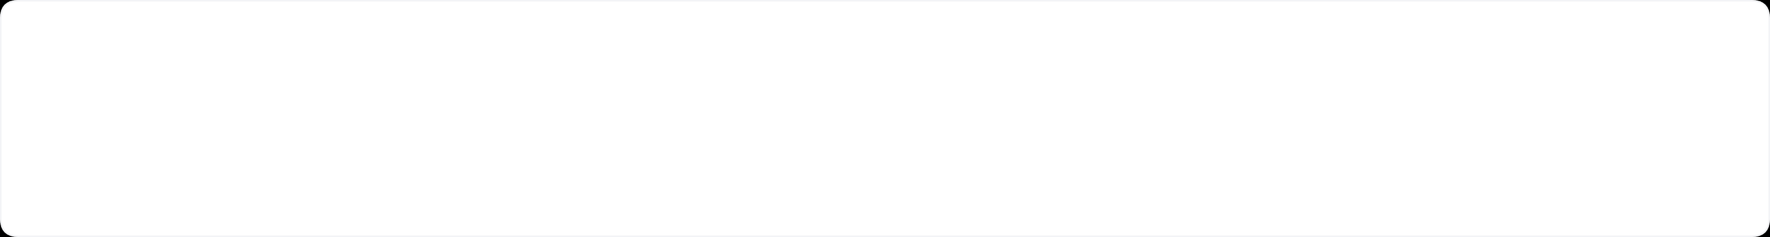



Module 8
Module Overview
What Promotion Really Is
It goes beyond just advertising. It's about communicating value, reducing customer uncertainty, and prompting meaningful action.
Two Guiding Principles
1) Be crystal clear in your value proposition.
2) Reach the right audience at the right time and place.
Strategic Alignment
Successfully matching your message and channel selection to customer behavior and their specific decision journey.
02
Principles of Marketing | Dr. Liz Kheng

Slide 3


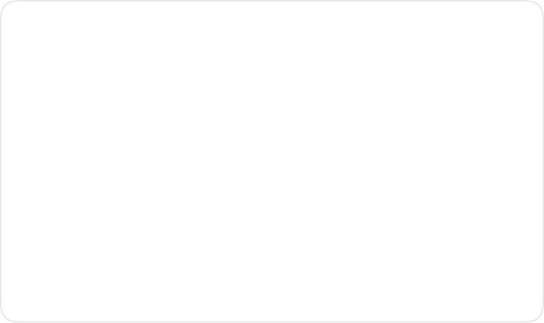





The Promotion Mix
What Promotion Includes
Five key elements used to communicate customer value
Advertising
Sales Promotion
Public Relations
Paid, non-personal presentation of ideas, goods, or services by an identified sponsor (TV, social ads, billboards).
Short-term incentives to encourage the purchase or sale of a product or service (coupons, contests, discounts).
Building good relations with publics to obtain favorable publicity and handle rumors (news, events, sponsorship).
Personal Selling
Direct & Digital Marketing
Personal interactions by the sales force to engage customers, make sales, and build relationships.
Engaging directly with targeted individual consumers and communities (email, social media, mobile).
03
Principles of Marketing | Dr. Liz Kheng

Slide 4
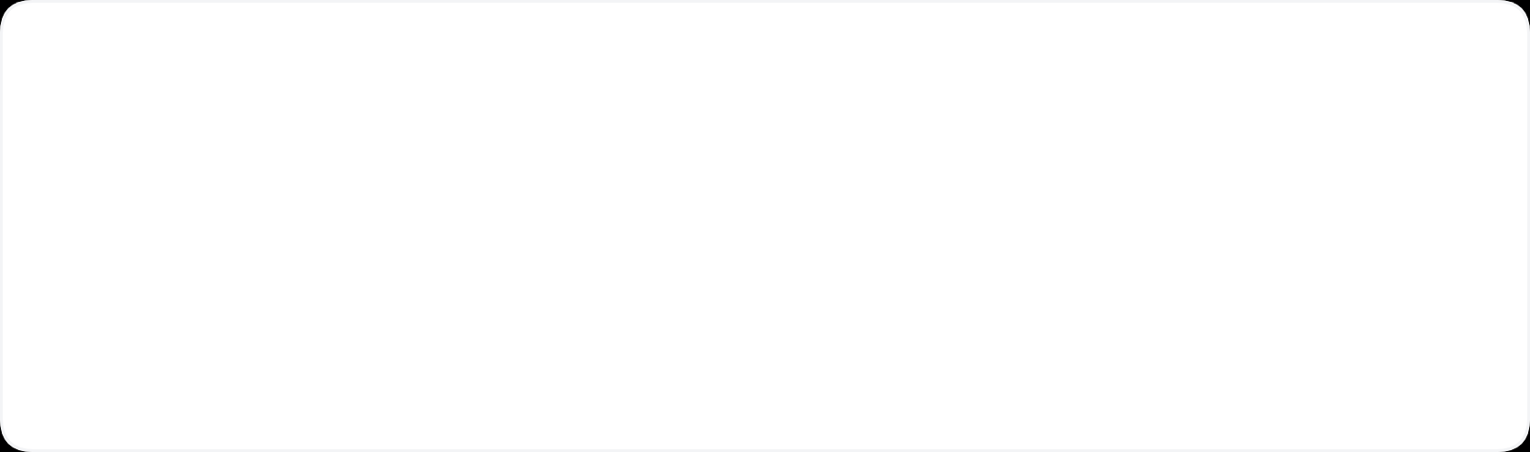




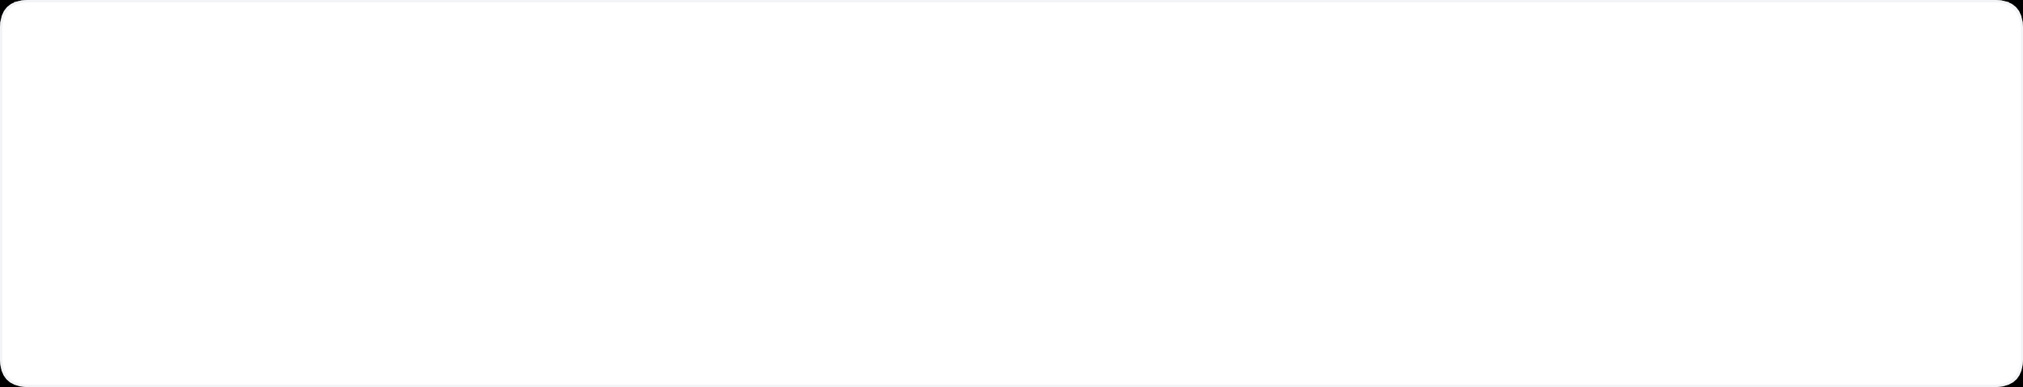

Module 8
Learning Objectives
Promotion vs. Advertising
Integrated Marketing (IMC)
Distinguish promotion from simple advertising and explain its broader role in communicating value to customers.
Define IMC and learn how to design consistent, unified messaging across multiple communication channels.
Funnel Tactics & Metrics
Value Propositions & CTAs
Map specific marketing tactics to funnel stages and select appropriate metrics to measure success.
Craft clear value propositions and compelling Calls to Action (CTAs) that drive customer engagement.
Campaign Planning Framework
Build a comprehensive SMART-goal campaign plan including goal, target, message, offer, channels, CTA, and metrics.
04
Principles of Marketing | Dr. Liz Kheng

Slide 5

Module 8 Fundamentals
Key Terms & Definitions
Promotion
Coordinated activities that communicate value, reduce perceived risk, and prompt desired actions.
IMC
Strategic coordination of all channels to deliver one consistent message and experience.
Integrated Marketing Communications
CTA
The explicit, singular next step you want the audience to take.
Call to Action
Metrics
Quantitative indicators that track performance across the funnel (e.g., reach, CTR, CVR, CAC, retention).
05
Principles of Marketing | Dr. Liz Kheng

Slide 6







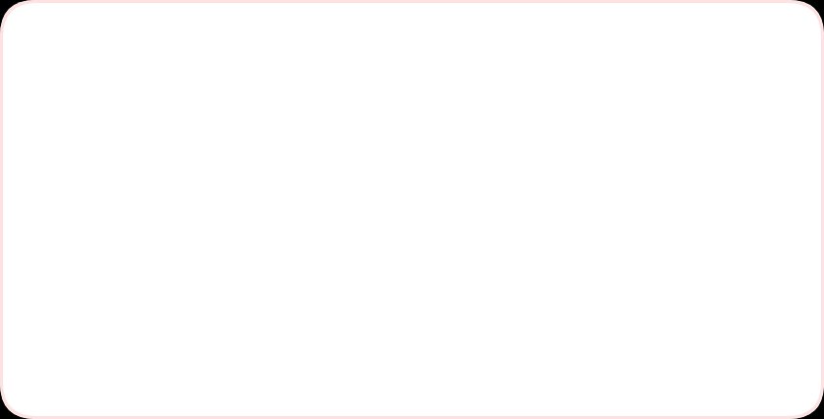




Part A: The Core Concept
Promotion = Communicating Value
Story: The "Viral" Campus Event
Social Hype
Actual Turnout
1,200+
23
Attention without clarity = Weak Results
Likes & Shares
Attendees
"Giveaways!"
Empty Room
Why It Failed (The Communication Gap)
Being "clever" or "viral" doesn't matter if your audience doesn't know exactly what to do next.
Missed Basics: Post hyped the "what" (prizes) but buried the "where" and "when".
High Friction: RSVP required DMing the account instead of a simple link.
Golden Rule
Inconsistency: Last-minute location change posted only on Stories (which expired).
"Clear beats clever when people are busy."
06
Principles of Marketing | Dr. Liz Kheng

Slide 7











Part B: Strategy
Integrated Marketing Communications (IMC)
Definition
Orchestrating multiple channels to tell one consistent story to the right audience.
Why It Matters
One
Consistent
Message
Builds Memory & Trust: Repetition of a consistent message reinforces brand identity.
Prevents Fragmentation: Ensures customers don't get mixed signals from different sources.
Improves Efficiency: Creating assets that work across channels saves time and budget.
The IMC Ecosystem
07
Principles of Marketing | Dr. Liz Kheng

Slide 8








IMC In Action
Case Study: Campus Tutoring
Aligned Strategy
The Unifying Core Message
"Quick, judgment-free help—book in 2 minutes"
5 Consistent Touchpoints
Instagram Reels
Email Campaign
QR Posters
In-Class Slides
LMS Banner
2-min booking demo + student testimonials + "Book now" link.
Subject: "Stuck? Get help in 2 min—no judgment" + button.
Placed in library/dorms with UTM-tracked codes for attribution.
Professors show 20-sec info slide at start of lecture.
"Book now—pick a 30-min slot today" direct link.
Campaign Results
+72%
35%
-18%
1:42
Bookings (MoM)
First-Time Users
No-Show Rate
Avg Booking Time

Slide 9
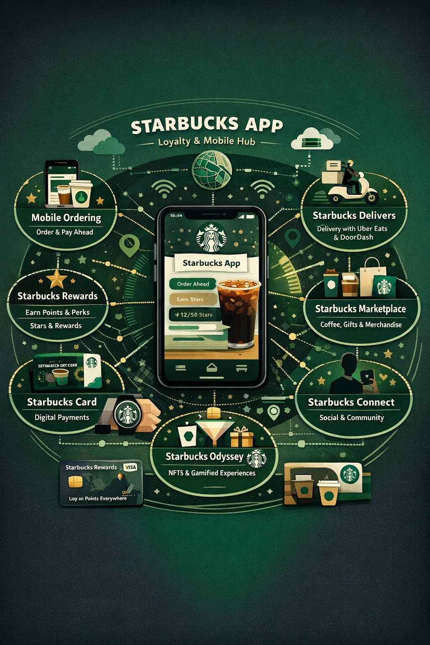







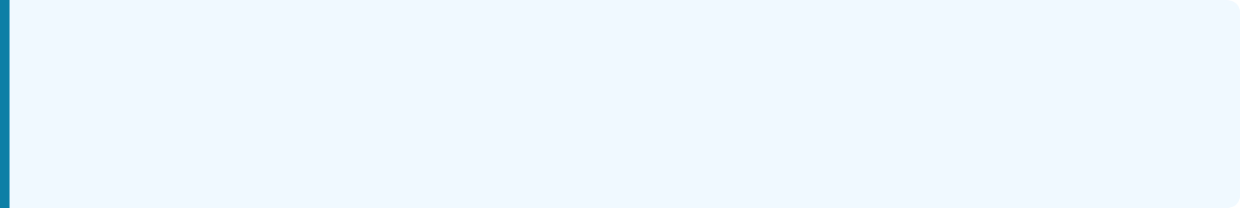


Brand Spotlight
Real-World Case Study
Starbucks
The "Third Place" Digital Ecosystem
IMC Elements Activated
App Personalization: AI-driven offers & push notifications.
Rewards Program: Gamified loyalty ("Star Dash").
In-Store Experience: Consistent signage & menu boards.
Seasonal Campaigns: Red Cup Day & Pumpkin Spice.
Social UGC: Encouraging customers to share their "Starbucks Moment".
Key Lesson
Tie product, app, and in-store experience to one value story: convenient indulgence rewarding your loyalty. The app isn't just a tool; it's part of the product.
Measurable Results
40M+
25%+
$$
Loyalty Members
Orders via Mobile
Higher Ticket Size
09

Slide 10
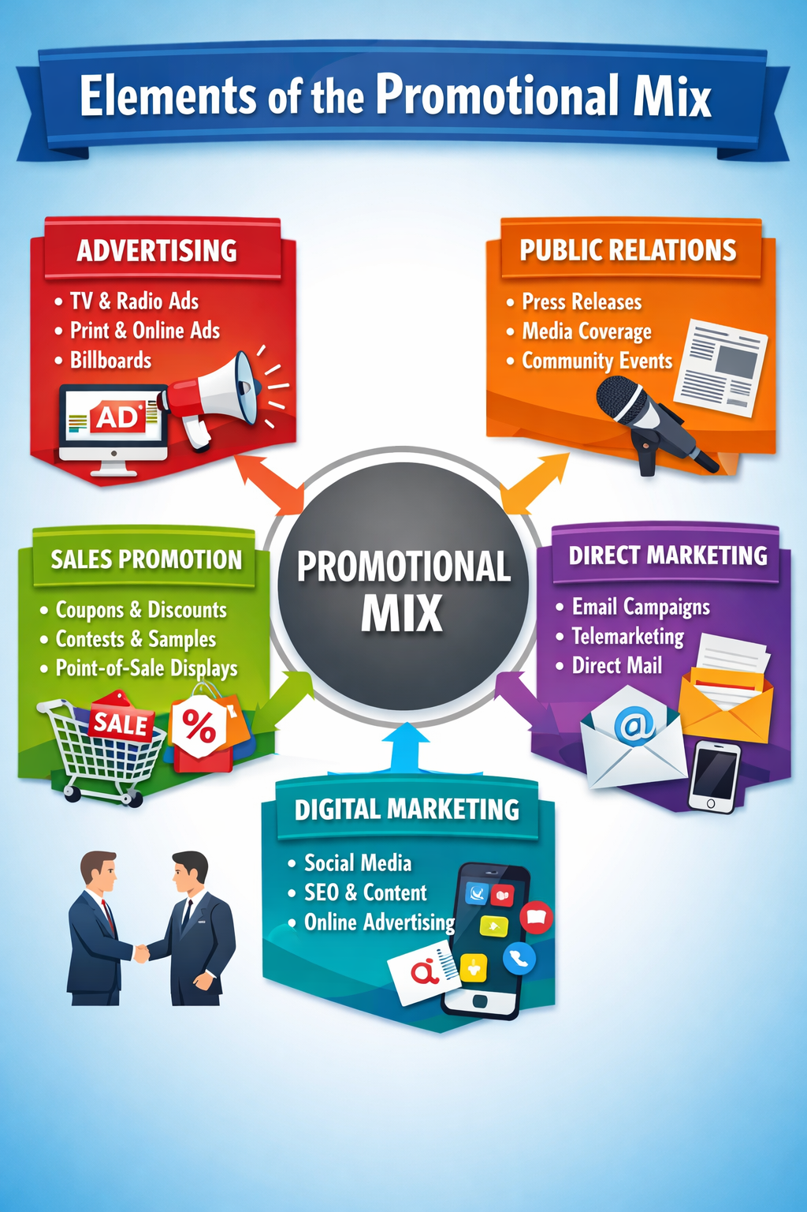






Real-World Case Study
Dove
The "Real Beauty" Campaign
Campaign Components
Viral Video: "Evolution" & "Sketches" films.
Social Conversation: #RealBeauty debates.
PR & Media: Talk shows & news coverage.
Workshops: Self-esteem education programs.
Paid Media: Billboards featuring real, unretouched women.
Key Lesson
Tell the same authentic story across every channel. When you stand for something real, your customers become your most powerful marketers.
Measurable Impact
2x
37%71%
30M+
Sales Doubled
Brand Awareness
Viral Views
10
Principles of Marketing | Dr. Liz Kheng

Slide 11




Real-World Case Study
Red Bull
Marketing Beyond the Can
Multi-Channel Activation
Owned Media: Red Bull Media House (TV, magazines, films).
Sponsorships: F1 Racing, X Games, hundreds of athletes.
Mega Events: Stratos Space Jump, Flugtag, Soapbox Race.
Field Marketing: "Wings Teams" & product sampling.
Retail POS: Distinctive branded fridges at checkout.
Key Lesson: Show, Don't Tell
Embed the product into the lifestyle rather than interrupting it. Red Bull doesn't just sponsor the event; they are the event content that people want to watch.
Measurable Results
~43%
$9B+
#1
Global Market Share
Annual Revenue
Energy Drink Brand
11
Principles of Marketing | Dr. Liz Kheng

Slide 12

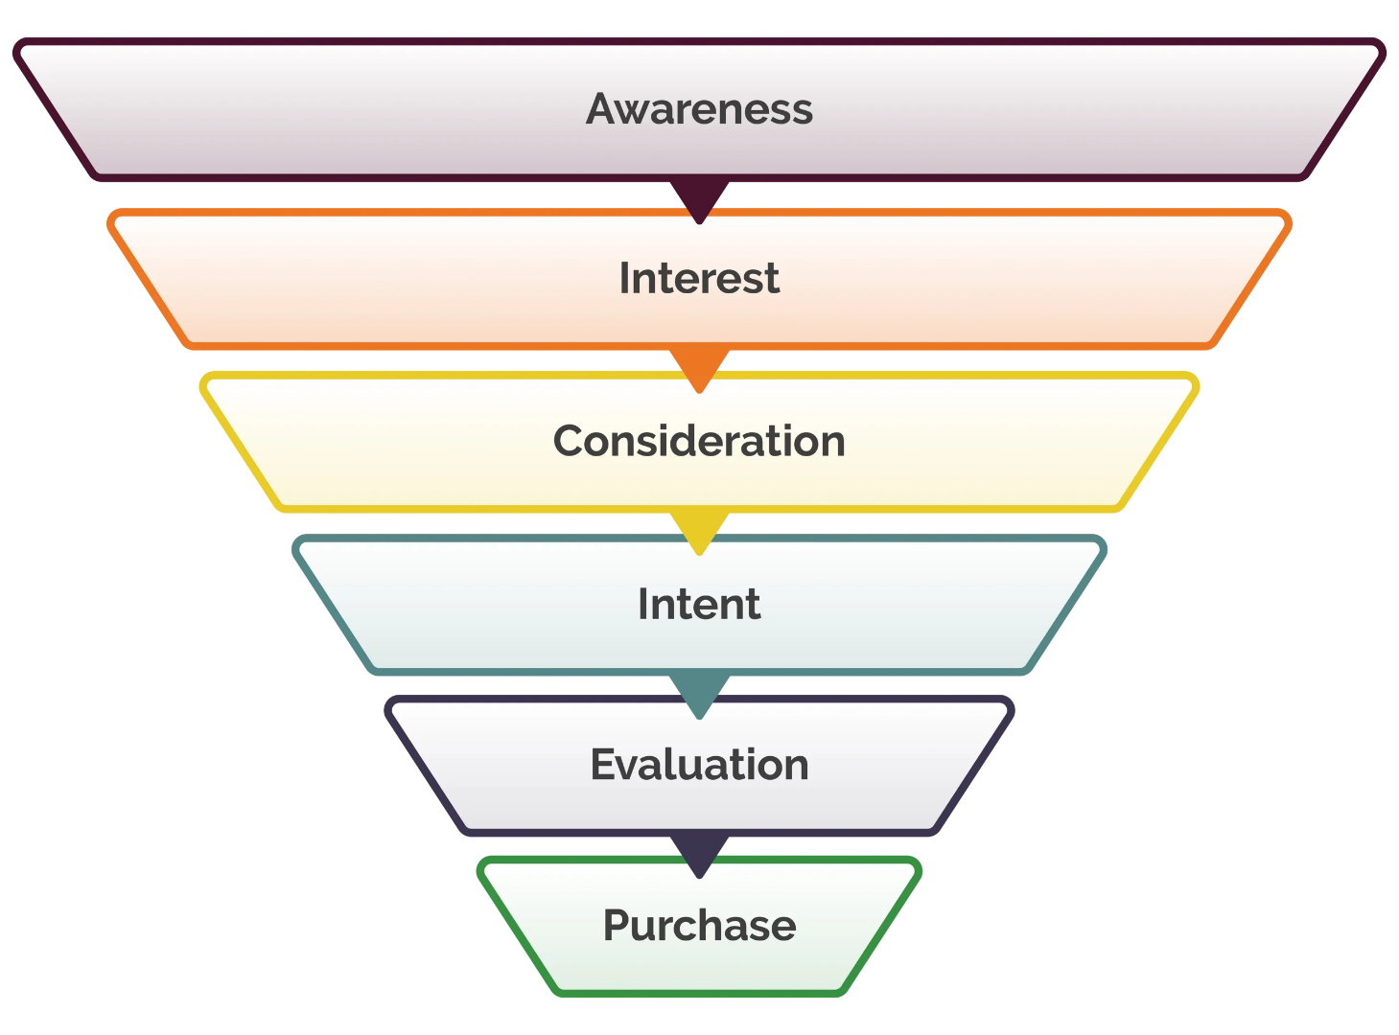
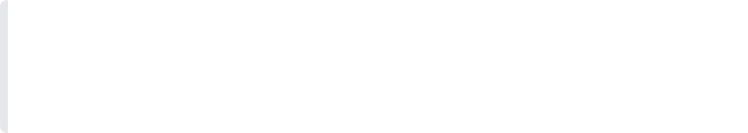
Customer Journey
The Marketing Funnel
Core Principle
Use a consistent message adapted with stage-appropriate tactics to guide customers from strangers to advocates.
01
Awareness
"I know you exist."
02
Interest
"I want to know more."
03
Consideration
"Is this right for me?"
04
Conversion
Visual Guide
"I'm buying."
The funnel narrows as intent increases, requiring more targeted communication.
05
12
Loyalty
"I'm telling my friends."
Principles of Marketing | Dr. Liz Kheng

Slide 13









Tactical Execution
Funnel Stages & Tactics
Framework
Stage
Customer Mindset
Tools / Tactics
Sample Metrics
Awareness
"I just heard about it"
PR, Paid Social, Influencers, SEO
Reach, Impressions, CPM, Share of Voice
Interest
"Tell me more"
Video, Blogs, Email Newsletters
CTR, Time on Page, Video Completion Rate
Consideration
"Is it right for me?"
Comparisons, Reviews, Webinars
MQLs, Add-to-Cart, Demo Requests
Conversion
"I'm ready"
Promos, Retargeting, Checkout UX
Conversion Rate (CVR), CPA, Revenue
Loyalty
"Worth it"
Onboarding, Loyalty Programs, Referrals
Retention Rate, Repeat Purchase, NPS, LTV
Note: Metrics should align directly with the goal of each stage. Don't measure "Awareness" with "Sales" directly—measure if people are seeing you first.

Slide 14





Part C: Strategy Essentials
Campaign Planning Framework
The 7 Essentials
1. Goal
What specifically are we trying to achieve? (SMART)
Successful campaigns aren't accidents. They are built on a solid foundation of seven core elements that align strategy with execution.
2. Target
Who is the primary audience for this message?
5. Channels
3. Message
Where will we reach them effectively?
What is the core value proposition?
6. CTA (Call to Action)
4. Offer
What is the single next step?
What incentive drives them to act now?
7. Metrics
How will we measure success?

Slide 15

















Applied Framework
Case Study: Movie Night Campaign
Student Org Example
The Plan
KPIs Tracked
Results
SMART Goal
Metrics defined before launch to measure funnel progression:
Total Attendees
Increase attendance by 30%
162
(120 → 156 students)
Reach
Awareness
Target Audience
First-year residents
35% (Beat Goal)
Within 10-min walk of Union
CTR (Click-Through)
Interest
Core Message
Reservations
Intent
"Free snacks. New friends. Big screen. 7pm @ Union Theater—limited seats."
Actual Attendance
Action
Reservations
190
Total sign-ups
Offer & CTA
Show Rate
Loyalty/Commit
Free popcorn + Raffle entry
Show Rate
85%
"Reserve your seat now"
Turnout %
Cost / Attendee
$1.85
Efficiency
16

Slide 16










Applied Framework
Case Study: Campus Food Truck
Small Business Example
Challenge & Plan
KPIs Tracked
Results (4 Weeks)
The Barrier
Metrics focused on efficiency and friction reduction:
Total Sales Increase
Low sales & "Long Wait" Myth
+35%
Students often cashless
Orders Per Day
Volume
The Solution
Significant Growth
"Order ahead, pick up in 10 min—pay with campus card. 10% student discount."
Avg. Wait Time
Experience
% Advance Orders
Adoption
Tactics
Repeat Purchase
Loyalty
IG Geo-stories, SMS Opt-in
Advance Orders
40%
QR Posters near lecture halls
Mobile adoption
Wait Time
-32%
Efficiency gain
Repeat Purchase
+22%
Customer retention
17

Slide 17

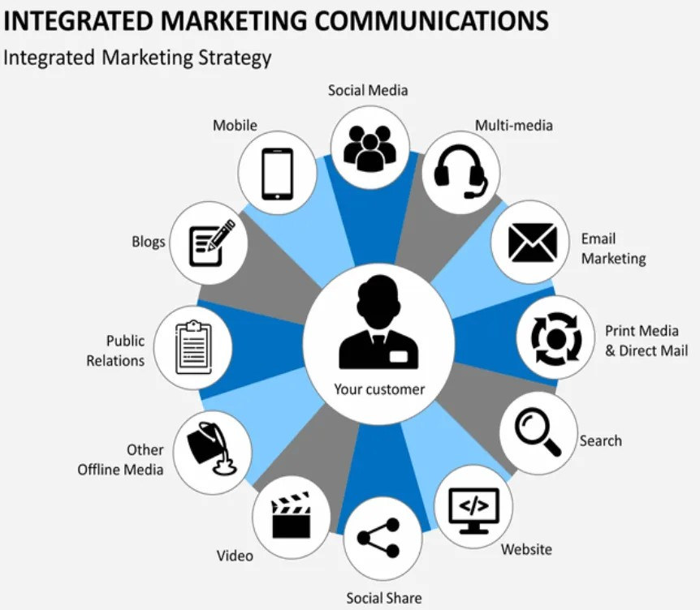







Strategic Framework
IMC Planning Process
Integrated System
A continuous loop from audit to measurement, ensuring every channel works together towards a common goal.
1. Audit
Analyze current situation
2. Goals
Set SMART objectives
3. Audience
Define target segments
4. Message
Craft core value proposition
5. Channels
Select media mix
6. Launch
Execute campaign
Process Cycle
7. Measure
The cycle doesn't end at launch; measurement feeds back into the next audit.
Track & Optimize
18

Slide 18

















Best Practices
Common Promotional Mistakes
Avoid These Pitfalls
The Mistake
Why It Fails
Better Approach
Clever > Clear
People miss the value or action because it's too abstract.
Lead with plain-language benefit + CTA
Promoting to "Everyone"
Wastes spend on irrelevant people; message becomes generic.
Define 1–2 high-value segments
Weak / Missing CTA
Audience is interested but doesn't know the specific next step.
One strong CTA, above the fold, repeated
One-and-done Blast
No reinforcement; relies on catching them at the exact right second.
Plan multi-touch sequence across funnel
Inconsistent Cross-channel
Confuses memory; looks like different brands; hurts trust.
One core message, adapted per channel
No Tracking / UTMs
Can't attribute success or optimize; "flying blind."
Set baselines, UTM every link, review weekly
19
Principles of Marketing | Dr. Liz Kheng

Slide 19


Module 8 Summary
Key Takeaways
Promotion Communicates Value
It’s not just noise—it reduces customer uncertainty and risk to prompt desired actions.
IMC Ensures Consistency
Orchestrating multiple channels to deliver one unified message builds trust and memory.
The Campaign Equation
Success requires: Goal + Audience + Message + Offer + CTA + Metrics.
Clear Beats Clever
When people are busy, clarity converts. Focus on the benefit and the next step.
20
Principles of Marketing | Dr. Liz Kheng

Slide 20


Module 8
Self-Check / Review
Promotion vs. Advertising
Can you clearly explain the difference between the broader concept of promotion and the specific tool of advertising?
Defining IMC
Can you define Integrated Marketing Communications (IMC) and why consistency matters?
The Marketing Funnel
Can you list the 5 funnel stages (Awareness → Interest → Consideration → Conversion → Loyalty)?
Campaign Application
Can you apply the 7-step campaign planning framework to a real-world scenario?
21
Principles of Marketing | Dr. Liz Kheng

Slide 21





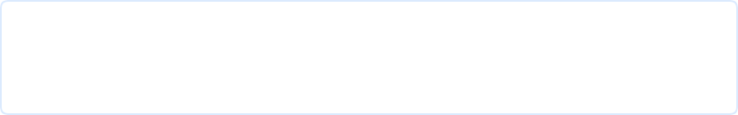


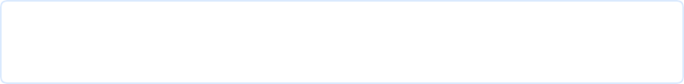
Module 8 Completed
Questions?
Let's discuss your campaign ideas.
Contact
Next Steps
Dr. Liz Kheng
Read Chapter 12: Promotion & Integrated Marketing Communications
Instructor
1
liz.kheng@university.edu
Email for appointments
2
Draft a 1-page campaign brief for your chosen campus service
Wednesdays 2:00 PM - 4:00 PM
Office Hours (Room 304)
3
Bring your draft to next week's workshop session
22
Principles of Marketing | Dr. Liz Kheng

