Slide 1


Chapter 6: Protecting the Idea

Slide 2


Key Learning Outcomes
IP Supports Value Creation
Protects and maximizes business value
Seeking Legal Guidance
Know when and who to consult
Essential IP Tools Explained
Understand patents, trademarks, copyrights

Slide 3

Why IP Matters
Signals legitimacy to partners
Builds trust and credibility
Raises barriers to imitation
Enhances competitive positioning
Supports premium pricing strategies
Differentiates through innovation

Slide 4
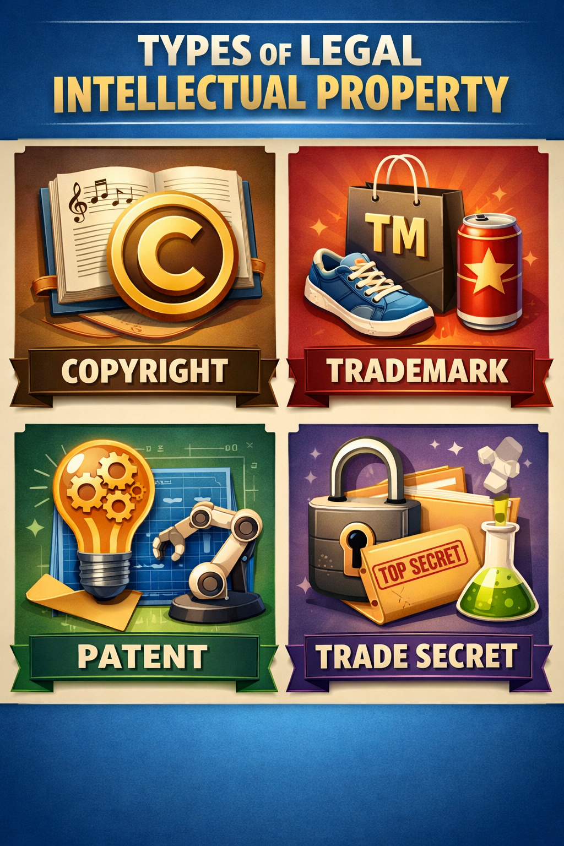
Intellectual Property Toolkit
Patents: Protect Your Inventions
Safeguard utility, design, plant
Trademarks: Safeguard Your Brand
Protect names, logos, identifiers
Copyrights: Protect Creative Works
Cover code, media, original content
Trade Secret: Protects Information
confidential business information that gives a competitive edge.
Example: Apple protects its iPhone technology through patents, its logo through trademarks, and its OS code via copyrights.

Slide 5
Types of IPs Explained
Patents: Protect Your Inventions
A patent gives the right to exclude others from using an invention.
Types:
  Utility – most common (e.g., engine design).
  Design – covers appearance (e.g., iMac shape).
  Plant – for new plant breeds.
First-to-file system: File ASAP to secure rights.
Example: Dyson's unique vacuum technology is protected by multiple utility patents.

Slide 6
Types of IPs Explained
Things to Consider with Patents
  Typical patent approval process: 1.5 to 3 years (can be faster or slower depending on complexity, backlog, and examiner review).
  Provisional patent application: Allows inventors to establish a filing date and claim “Patent Pending” for 12 months before filing a full application.
Duration of Protection
  Utility patents: 20 years from filing date.
  Design patents: 15 years from the date of grant.
  Plant patents: 20 years from filing date.
Renewal / Maintenance
  Utility & plant patents: Require maintenance fees at 3.5, 7.5, and 11.5 years after the grant to keep the patent in force.
  Design patents: No maintenance fees required.
  If fees aren’t paid → the patent expires early.

Slide 7
Types of IPs Explained
Global Considerations
  Protecting inventions globally is essential in a globalized world.
  Global Dossier, Patent Prosecution Highway, and partnerships with the European Patent Office streamline the process.
  Example: Filing in China, EU, and U.S. protects products across major markets.
  Don’t copy patented products—check USPTO.gov.
  Improvements on existing patents may be legal.
  Licensing can provide a legal workaround.
Example: Google licenses patents from smaller firms to improve products without infringing.

Slide 8
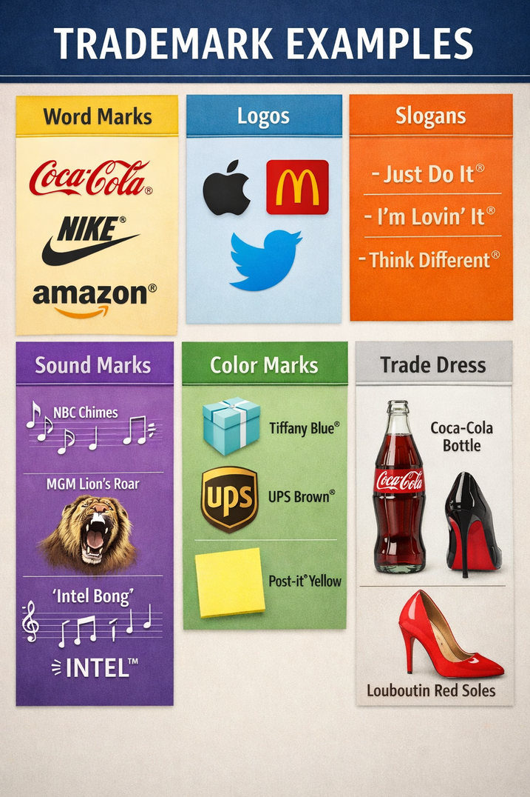
Types of IPs Explained
Trademarks
  Protects brand identity (names, logos, symbols).
  Lasts indefinitely with use and renewal (every 10 years).
  PTO registration requires:
  Application, drawing, usage samples, and fees.
Example: Nike's “swoosh” and slogan “Just Do It” are protected trademarks.
  Exclusive use across the U.S.
  Enables legal action in federal court.
  Protects from imports with similar marks.
  Allows international filings.
  Enables ® symbol use.

Slide 9
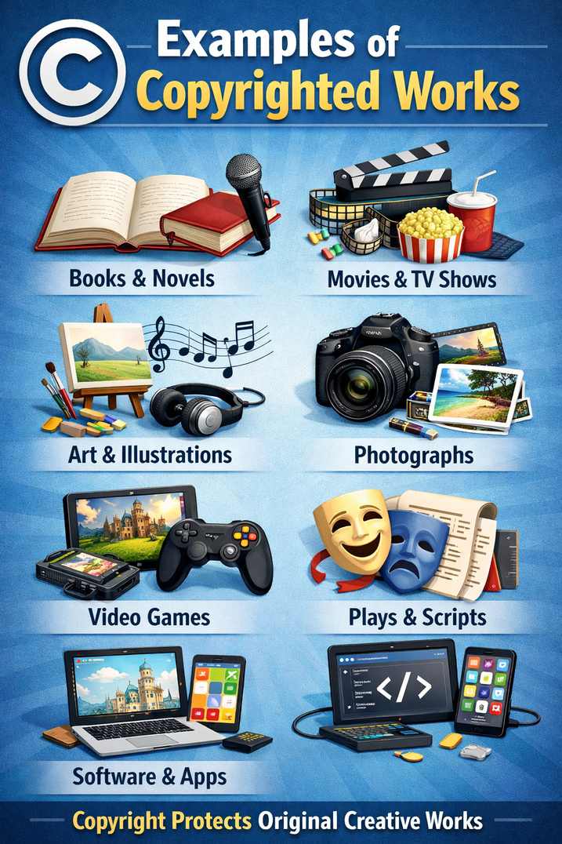
Types of IPs Explained
Copyright
  Protects original works (books, music, software).
  Does not protect the idea, only the expression.
  No lawyer needed—register at the Library of Congress.
  Duration: Life + 70 years.
Example: J.K. Rowling’s Harry Potter series is copyrighted, though the “wizard school” idea is not.

Slide 10
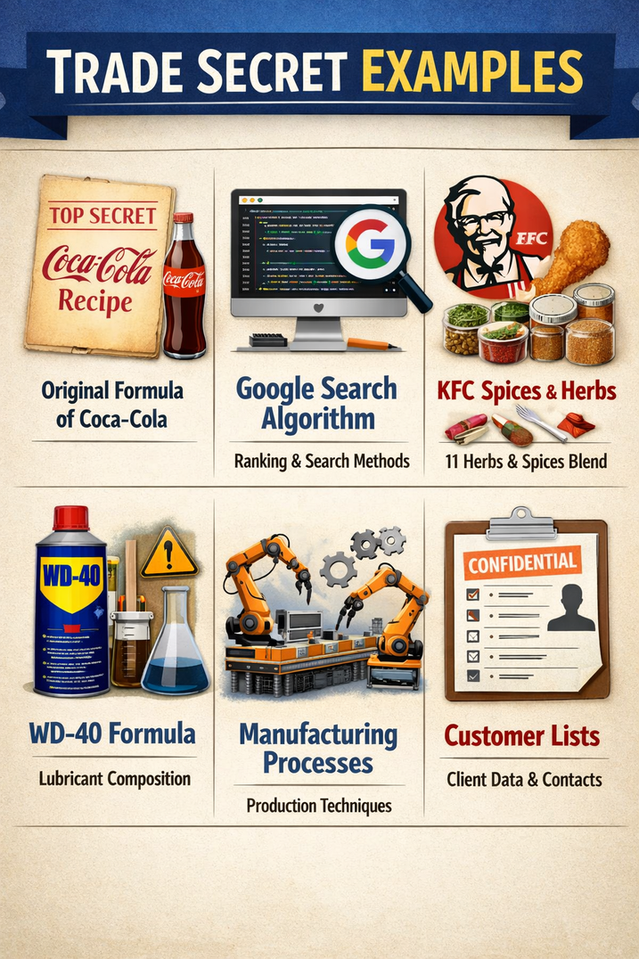
Types of IPs Explained
Trade Secret
A trade secret is confidential information that gives a business a competitive advantage (e.g., the Coca-Cola formula). Unlike patents, trade secrets are protected as long as they remain secret and the company takes reasonable steps to safeguard them.
How businesses protect trade secrets
  Use NDAs (non-disclosure agreements) for employees, contractors, and partners
  Limit access with need-to-know permissions and secure systems
  Use noncompete / non-solicitation agreements where legally enforceable
  Train staff on confidentiality policies
Example
A software startup treats its source code as a trade secret by restricting access to key developers, using NDAs, and controlling permissions in its code repository.

Slide 11

Legal Guidance for Ventures
Know Your Industry Regulations
Every business faces unique rules
Legal Needs Expand Over Time
Hiring, contracts, and compliance matters
Select Your Counsel Wisely
Choose a lawyer as an asset
Small Business Administration (SBA)
The U.S. Small Business Administration can help entrepreneurs understand common legal requirements

Slide 12

Setting Up Your Organization
Liability Protection for Founders
Shield personal assets securely
Tax Structures Matter
Understand your tax obligations
Plan for Business Continuity
Prepare for founder transitions

Slide 13
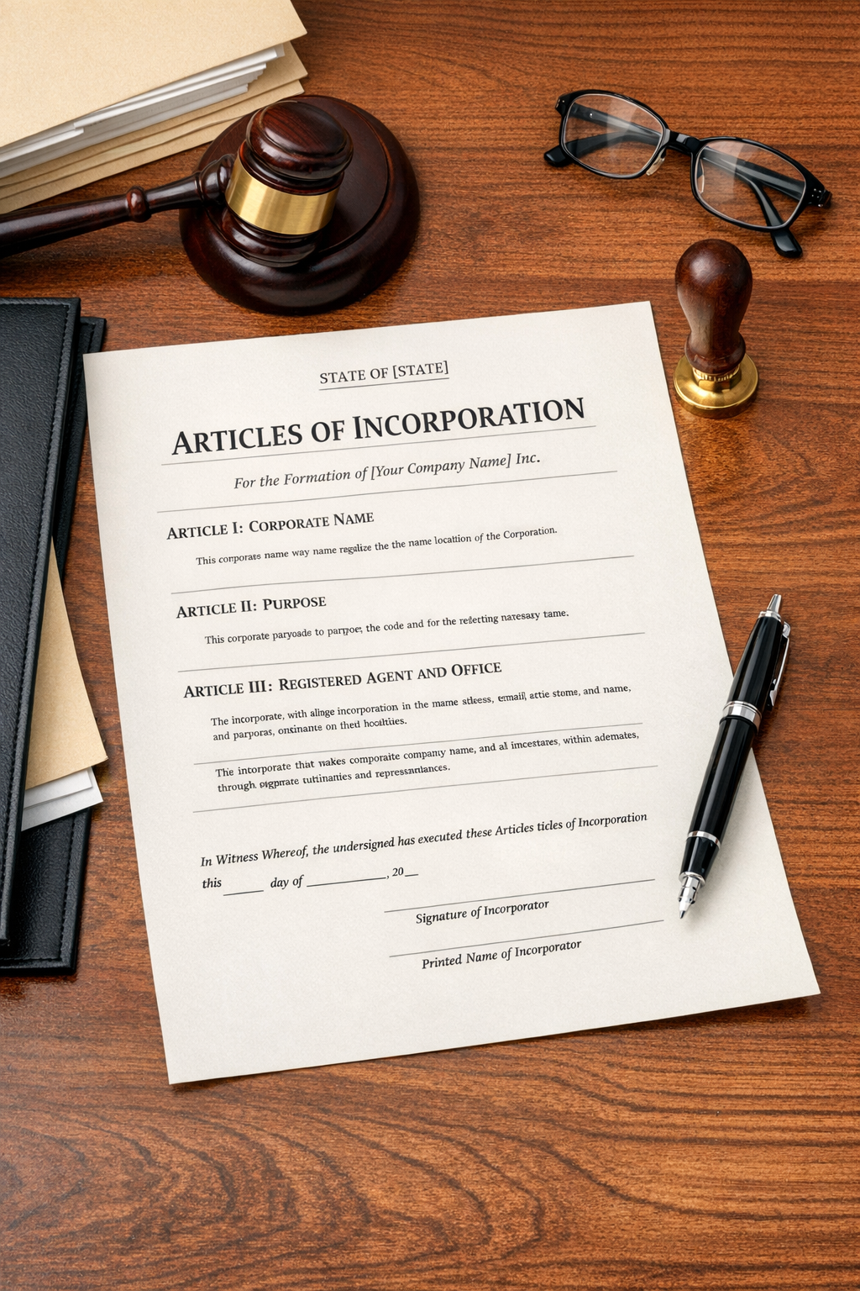
Setting up the Organization
Key legal decisions during startup formation:
  Liability: Separates business risk from your personal finances. An LLC or corporation can help protect personal assets if the business is sued or can’t pay its debts.
  Taxes: Your legal structure affects how profits are taxed. For example, a sole proprietorship is usually taxed on the owner’s personal return, while an S-corp may offer different payroll/profit tax treatment.
  Continuity: Determines what happens if a founder leaves, becomes incapacitated, or passes away—some structures make it easier for the business to keep operating.
  Transferability: Impacts how easily ownership can change hands. Some structures allow you to sell or transfer shares more smoothly than others.
  Raising capital: Affects funding options. Many investors prefer corporations because ownership is defined through shares and governance rules.

