Slide 1

Thinking Like an Entrepreneur
Workshop Guide: Mindset, Habits, and Tools
Dr. Kheng - MGMT 420

Slide 2

Workshop Purpose
Understanding the goals and outcomes of this entrepreneurial workshop
  Recognize opportunity signals and act on them
  Make decisions with incomplete information and build resilience
  Use practical tools for experimentation and risk management

Slide 3
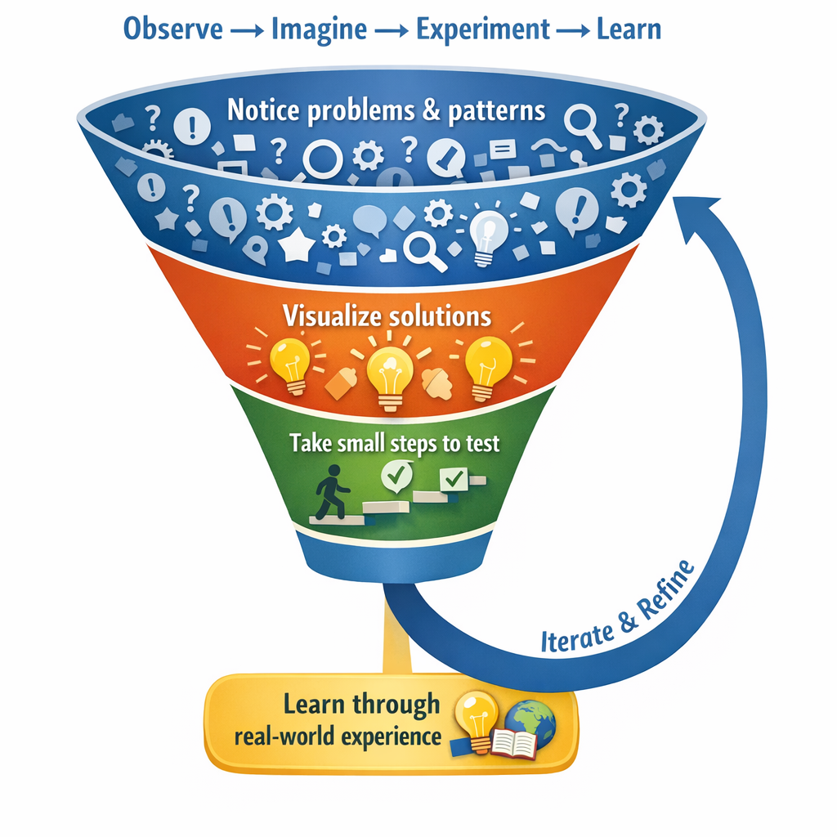
Thinking Like an Entrepreneur
Cultivating a mindset to identify opportunities and take action
  Notice problems and patterns
  Visualize potential solutions
  Take small steps to test ideas
  Learn through real-world experiences

Slide 4
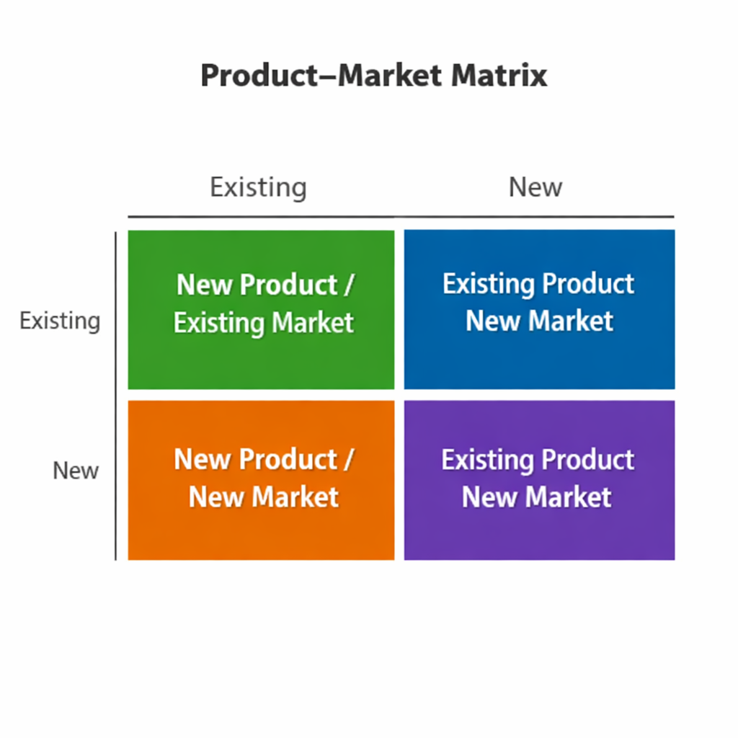
Opportunity Patterns
Understanding where opportunities arise in markets and products is crucial
  New market: existing solutions for new audiences
  New product: better solutions for existing audiences
  Novel solution: new products for new markets

Slide 5
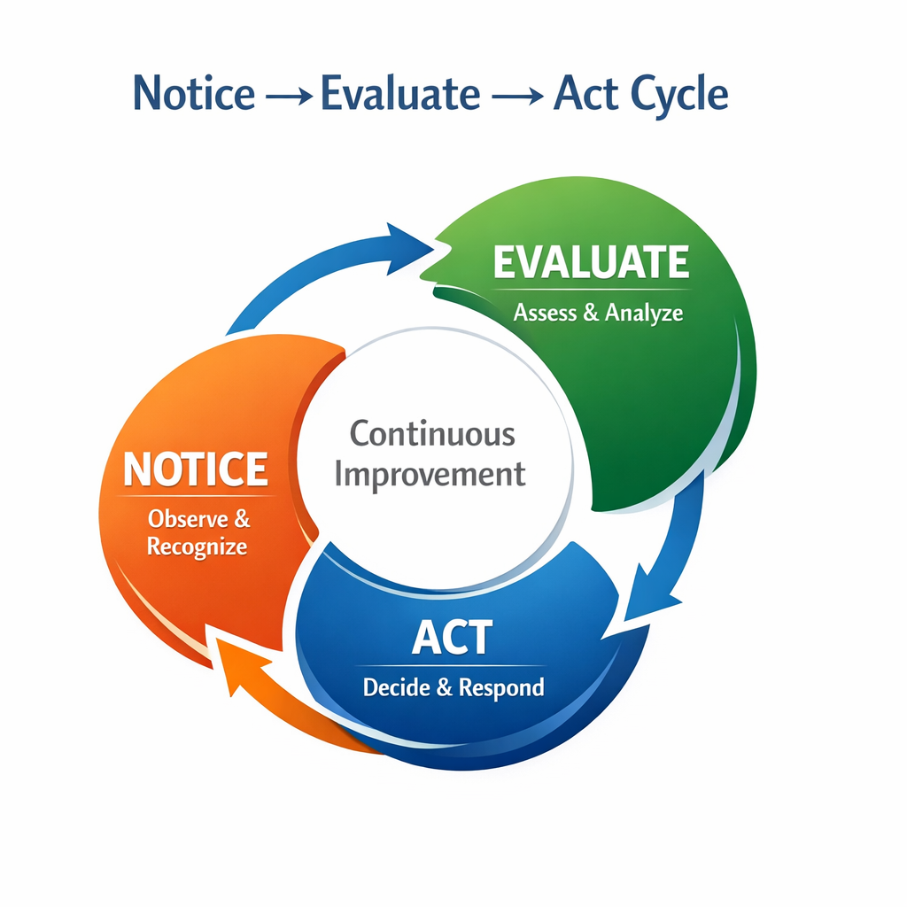
From Noticing to Doing
Transform entrepreneurial insights into actionable steps for success
  Entrepreneurship = small steps that create learning
  Notice → Evaluate → Act
  Don’t wait for certainty; design the next test

Slide 6
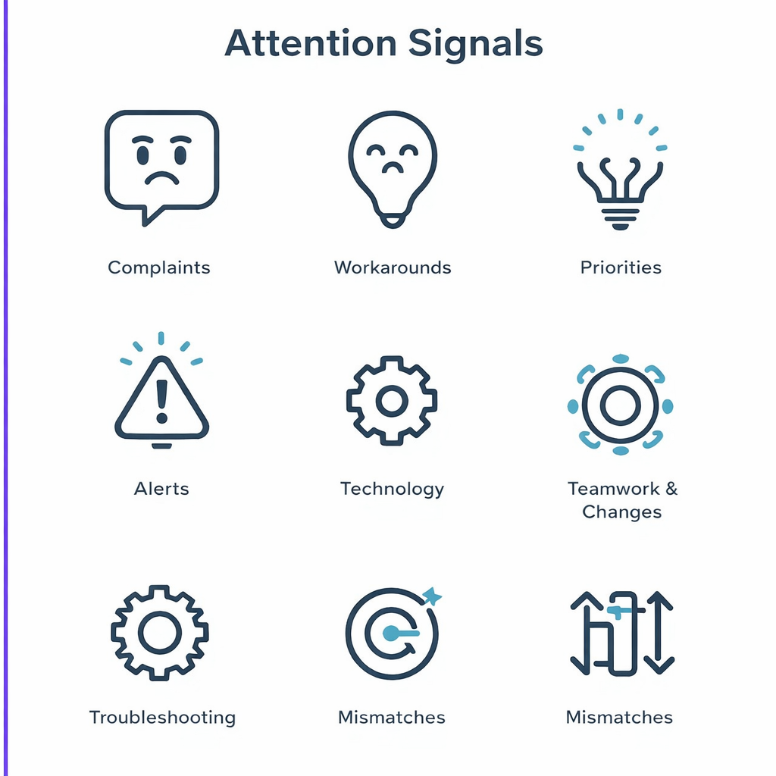
Attention Signals
Identify the key indicators of entrepreneurial opportunities in daily life
  Repeated complaints indicating unmet needs
  Workarounds that reveal existing frustrations
  Changes in technology, rules, or trends
  Mismatches between desires and available solutions

Slide 7
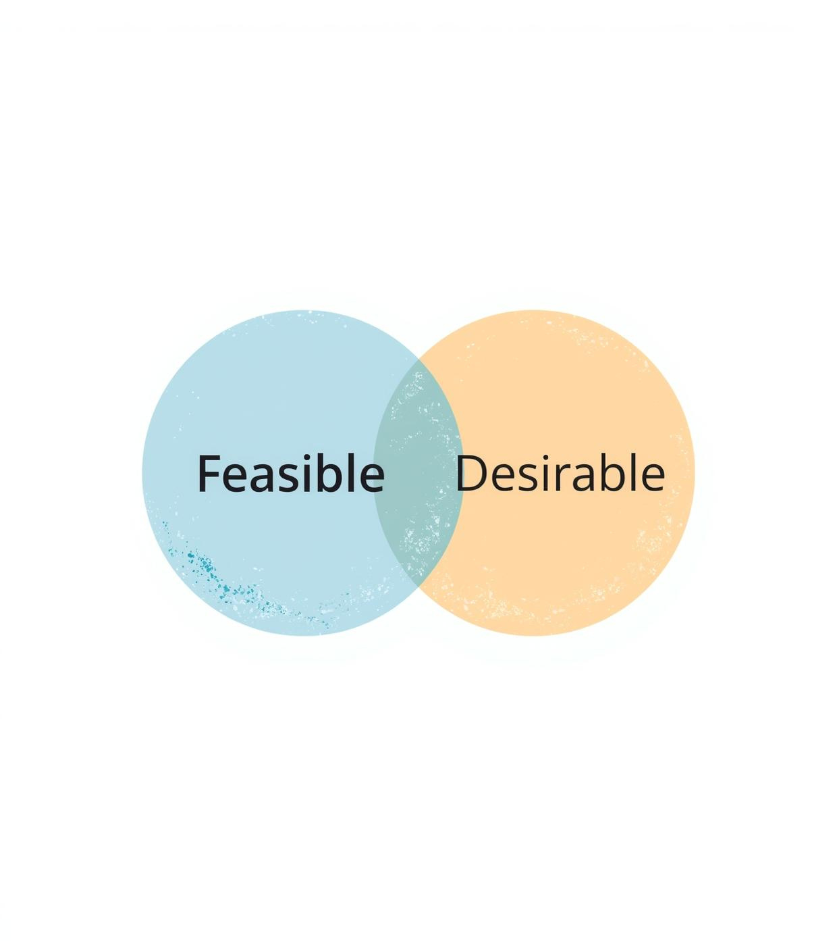
Evaluation Criteria
Assessing feasibility and desirability for entrepreneurial opportunities
  Feasibility: Can it be done with available resources?
  Desirability: Do people want it enough to adopt or pay?
  Ask users: Who would use it first and how often?

Slide 8

Take Small Steps
Design tests to learn quickly, not to achieve perfection.
  Conduct interviews with five target users
  Create mockups to visualize solutions
  Pilot with a small group for feedback
  Deliver manually before building technology
  Offer trial solutions to gauge interest

Slide 9
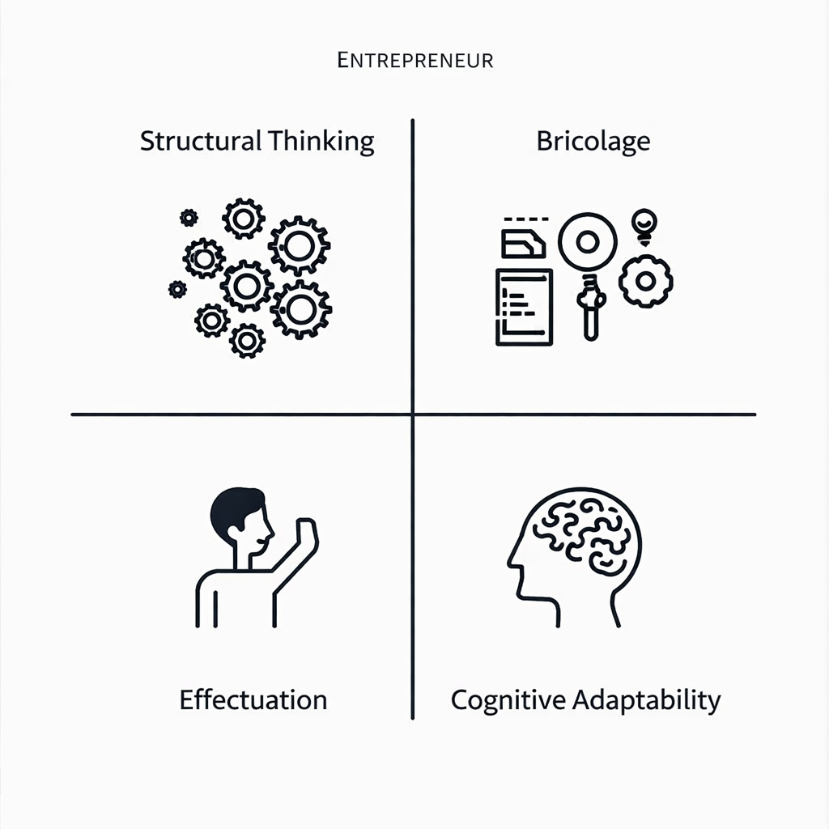
Core Thinking Patterns
Four essential mental tools for entrepreneurial decision-making and action
  Structural Thinking
  Bricolage
  Effectuation
  Cognitive Adaptability

Slide 10

Structural Thinking
Understanding how to look deeper for effective solutions
  Ask what the situation is really like
  Identify underlying structures affecting outcomes
  Borrow solutions from different fields

Slide 11

Bricolage
Leveraging existing resources creatively to drive progress and innovation
  Repurpose tools for new uses
  Borrow space and leverage networks
  Prototype manually before building technology
  Use constraints as design inputs

Slide 12
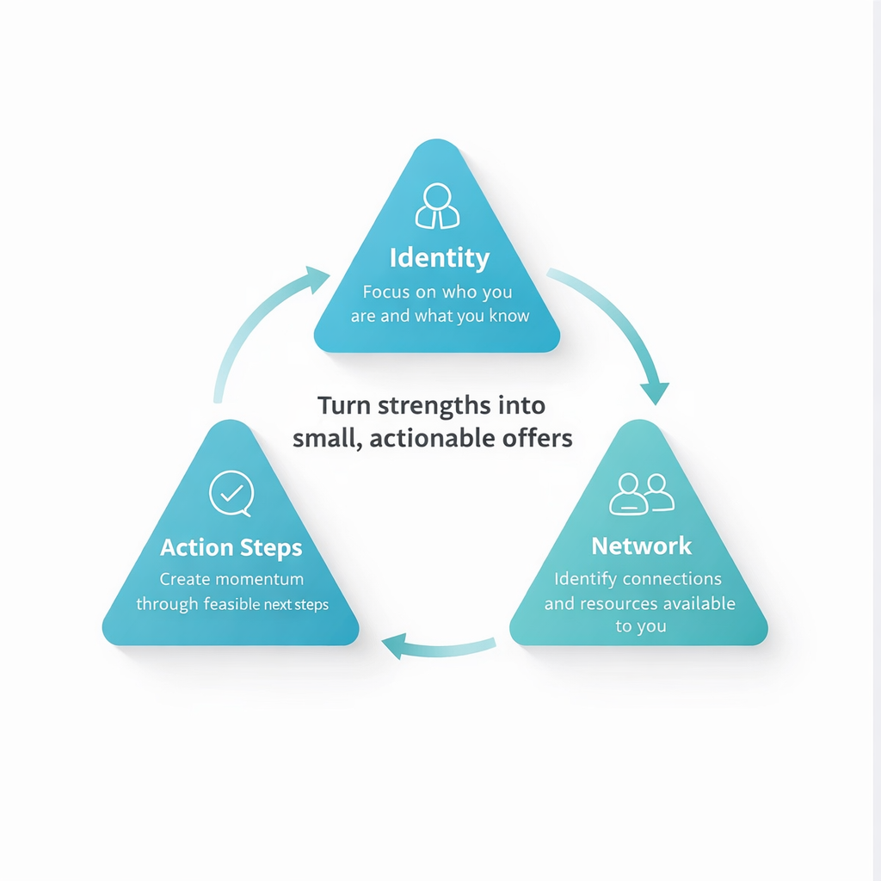
Start From Your Means
Leverage your strengths, skills, and networks to create value efficiently
  Focus on who you are and what you know
  Identify connections and resources available to you
  Create momentum through feasible next steps
  Turn strengths into small, actionable offers

Slide 13

Cognitive Adaptability
Adjusting your thinking as new information emerges while learning
  Comprehension: what’s happening? what’s assumed?
  Connections: what patterns repeat?
  Strategy: what are the options and next best move?
  Reflection: what did we learn and change?

Slide 14

Key Characteristics
Expand entrepreneurial traits that can be actively developed and practiced
  Opportunity recognition
  Proactivity and initiative
  Resilience and adaptability
  Creativity and innovation
  Calculated risk-taking
  Determination and persistence
  Resourcefulness
  Continuous learning

Slide 15

Opportunity Recognition
Training yourself to see opportunities in everyday frictions and challenges
  Identify repeated complaints and frustrations
  Keep a friction journal to capture signals
  Look for unmet needs and workarounds

Slide 16
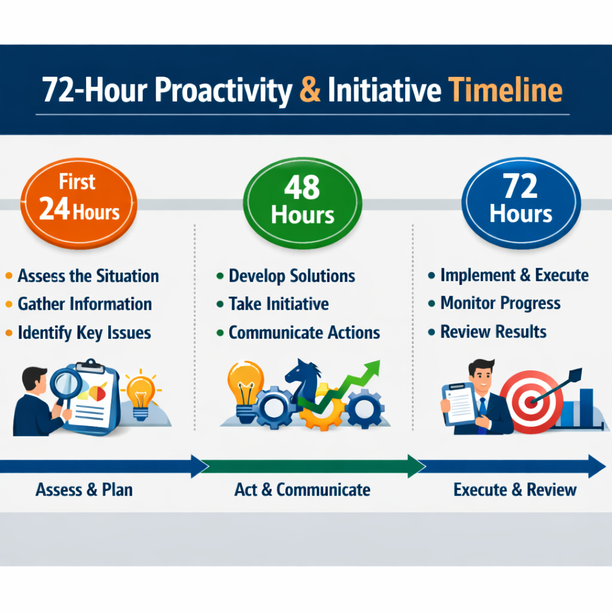
Proactivity & Initiative
Create motion and take action without perfect conditions or timing
  Turn “cool idea” into a test
  Build processes, not just one-time fixes
  Use a 72-hour action plan

Slide 17
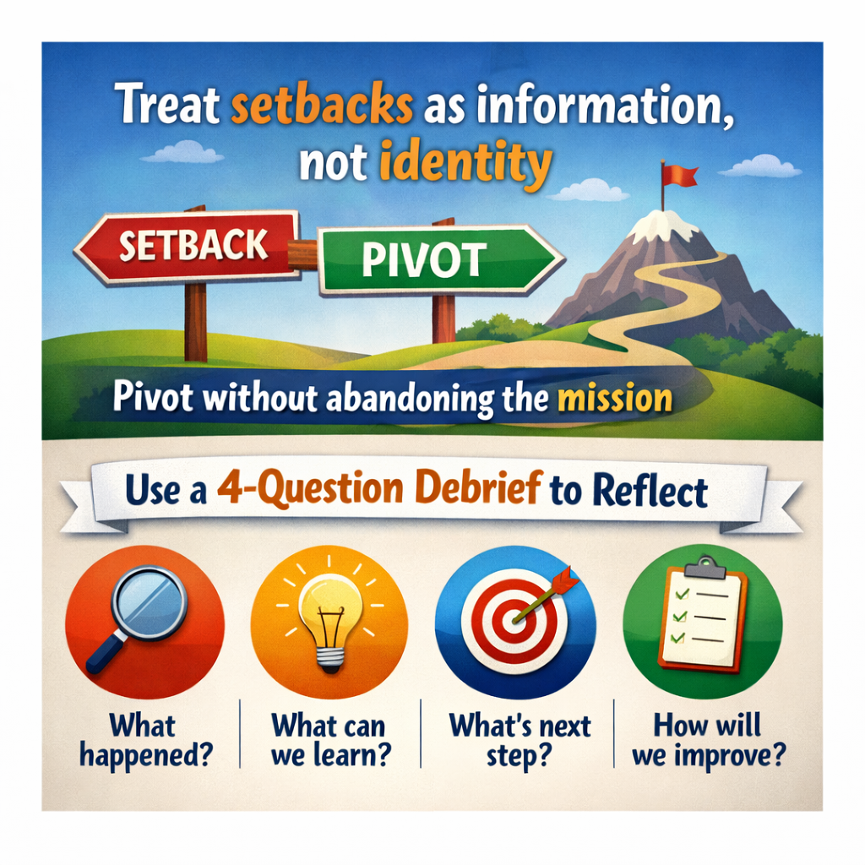
Resilience & Adaptability
Learn to view setbacks as opportunities for growth and transformation.
  Treat setbacks as information, not identity
  Pivot without abandoning the mission
  Use a 4-question debrief to reflect

Slide 18
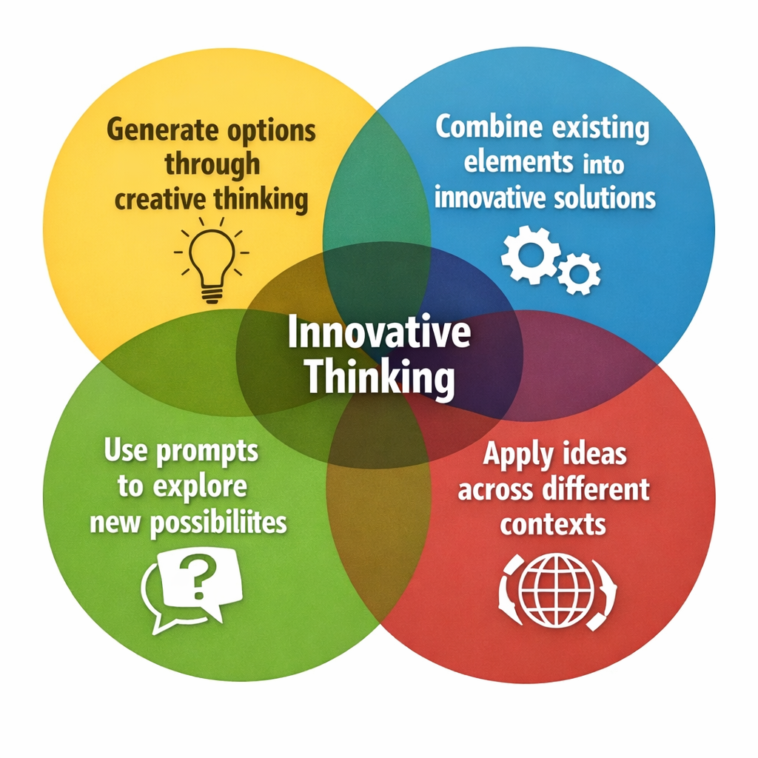
Creativity & Innovation
Combining familiar ideas to create new value in the market
  Generate options through creative thinking
  Combine existing elements into innovative solutions
  Use prompts to explore new possibilities
  Apply ideas across different contexts

Slide 19
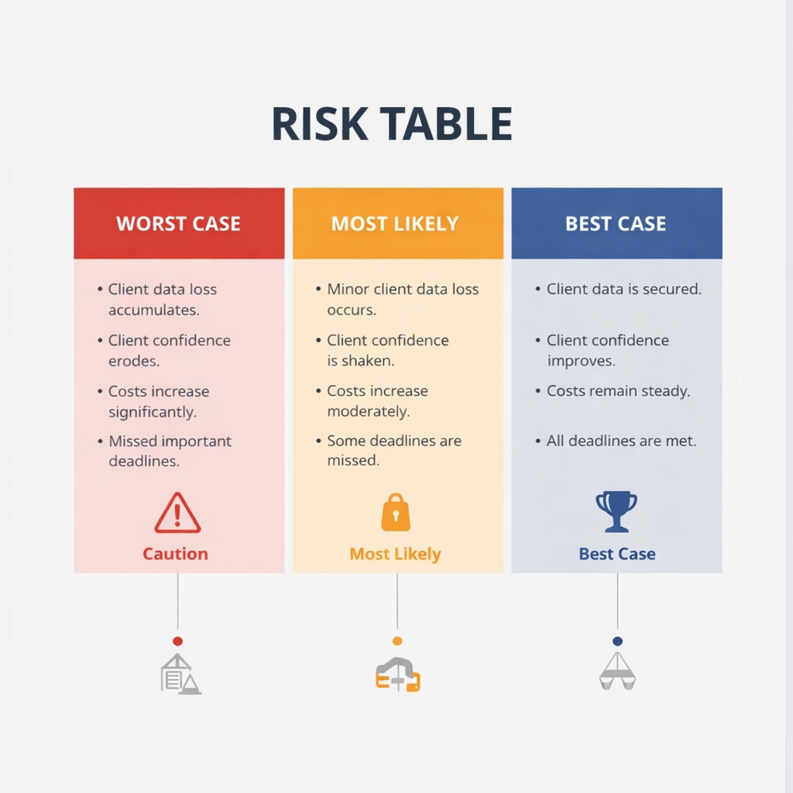
Calculated Risks
Smart risk-taking strategies to minimize uncertainty and maximize learning
  Take survivable risks
  Reduce uncertainty with experiments
  Make decisions reversible
  Use a Worst/Likely/Best risk table

Slide 20
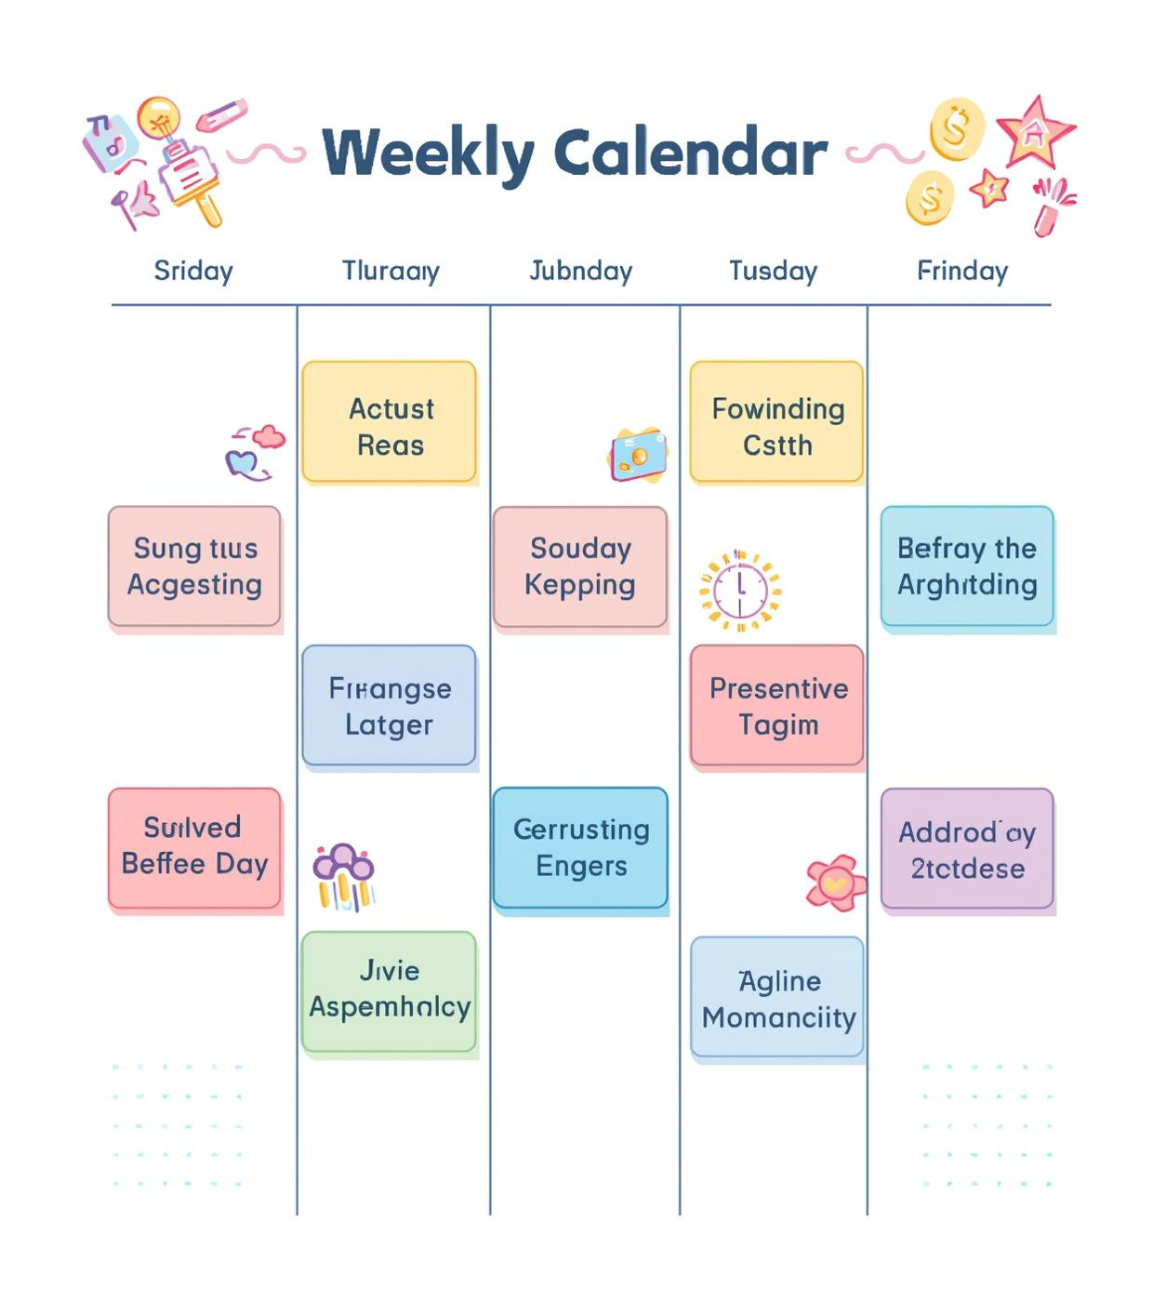
Determination & Persistence
Building habits of consistency to achieve long-term goals and success
  Consistency beats intensity
  Iterate after weak feedback
  Keep momentum through milestones
  Define weekly “wins”
  Show up, even when progress is slow

Slide 21
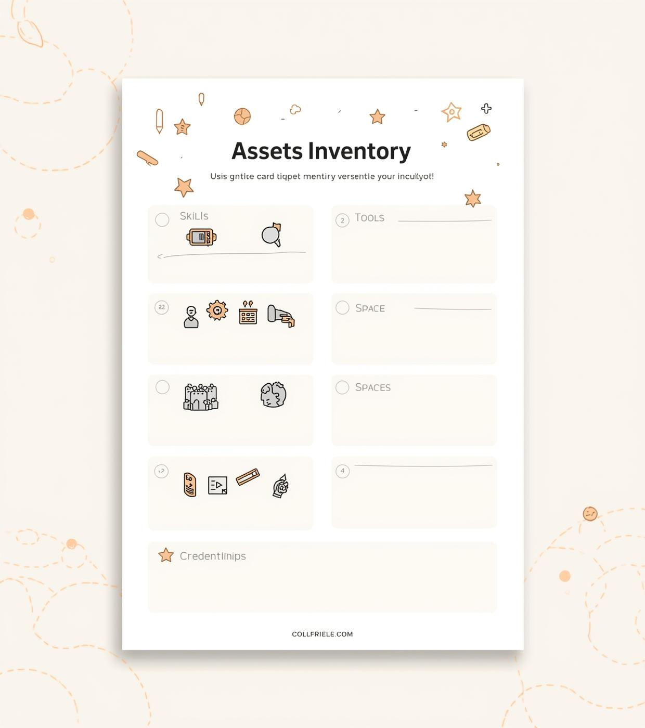
Resourcefulness
Leveraging available assets to maximize problem-solving capabilities and outcomes
  Use time effectively
  Repurpose existing tools
  Leverage networks and relationships
  Combine skills for innovative solutions

Slide 22

Continuous Learning
Ongoing skill-building and curiosity to expand your entrepreneurial capacity
  Curiosity expands what's feasible
  Build breadth to see opportunities
  Learn from action through reflection
  Use a weekly 5-minute review

Slide 23

Mini Toolkit
Engaging group activities to practice entrepreneurial thinking and skills
  Opportunity safari: List 10 frictions experienced this week
  Means-to-next-step: Design a 48-hour experiment
  Bricolage prototype challenge: Build a prototype using existing materials
  Feasible + desirable scorecard: Rate an idea 1–5 and pick an action
Click here to read more about these activities.

