Slide 1


Week 15: Exit Strategy
Dr. Liz Kheng

Slide 2

Exit Strategy Options
Key pathways for business transitions
IPO
Private Sale
Succession
An Initial Public Offering (IPO) allows a company to sell its shares to the public, providing capital for growth while enhancing visibility and credibility in the market.
A private sale of stock involves selling ownership to selected buyers, often allowing for a smoother transition and tailored negotiations, reducing market exposure during the process.
Succession planning focuses on preparing the next generation of leaders, ensuring a smooth transition of ownership, and addressing family dynamics, employee roles, and financial implications effectively.
2

Slide 3
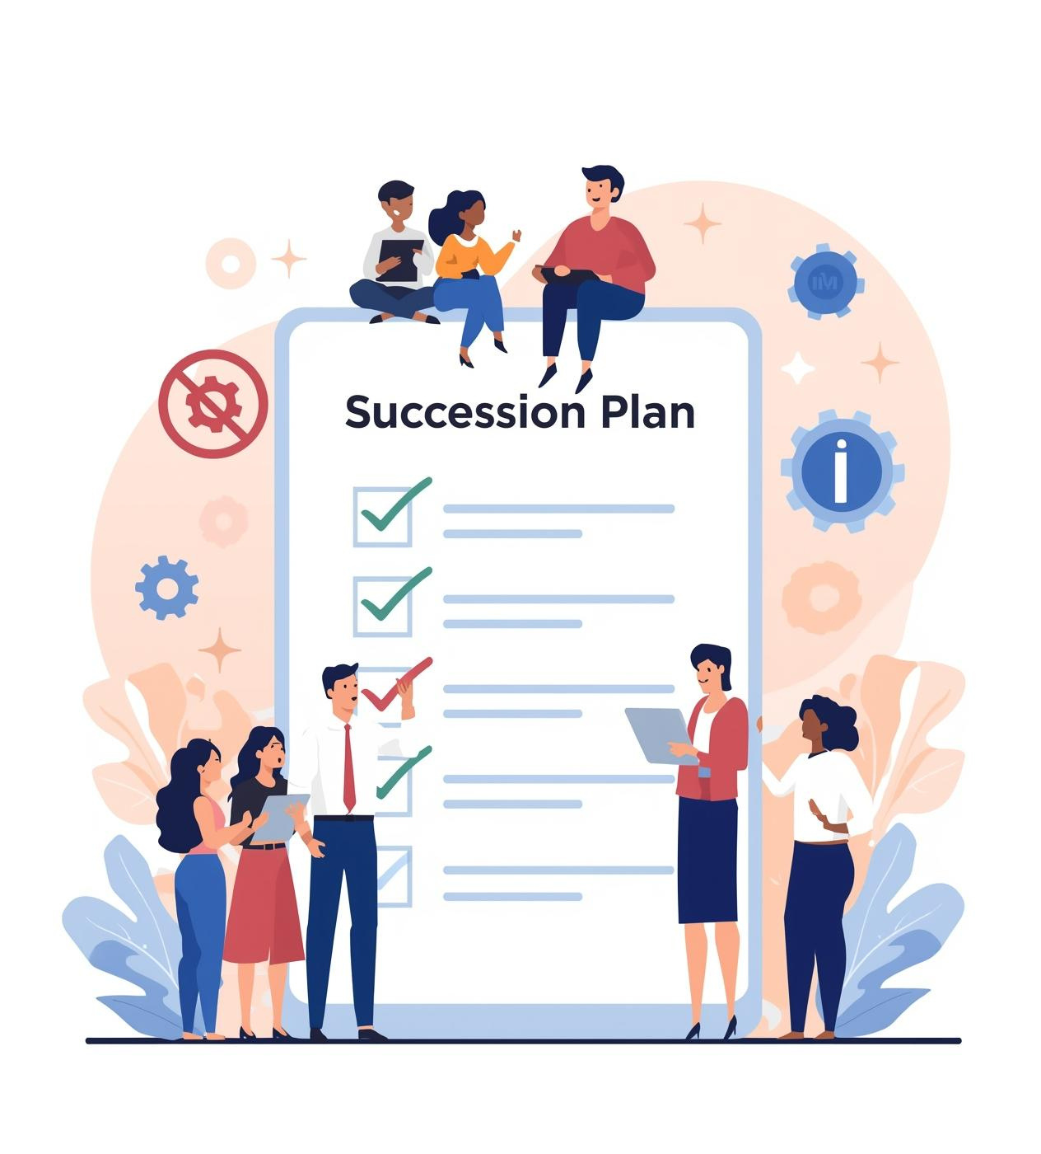
Key Considerations for Succession Planning
Effective succession planning involves addressing the owner’s role, family dynamics, income needs, business environment, and loyal employees, ensuring a smooth transition and minimizing potential conflicts during the process.

Slide 4
Alternatives for Succession
Explore options when family is uninterested
Train Employee
Hire Manager
Sell Business
Training a key employee can facilitate a seamless transition while retaining some equity, ensuring that the business's vision and culture remain intact during the changeover.
Retaining control by hiring a capable manager allows the owner to maintain oversight while bringing in expertise to run operations effectively, ensuring the business thrives.
Selling the business outright is a straightforward option, providing immediate liquidity and allowing the owner to exit the business while transferring responsibilities to new owners.
4

Slide 5
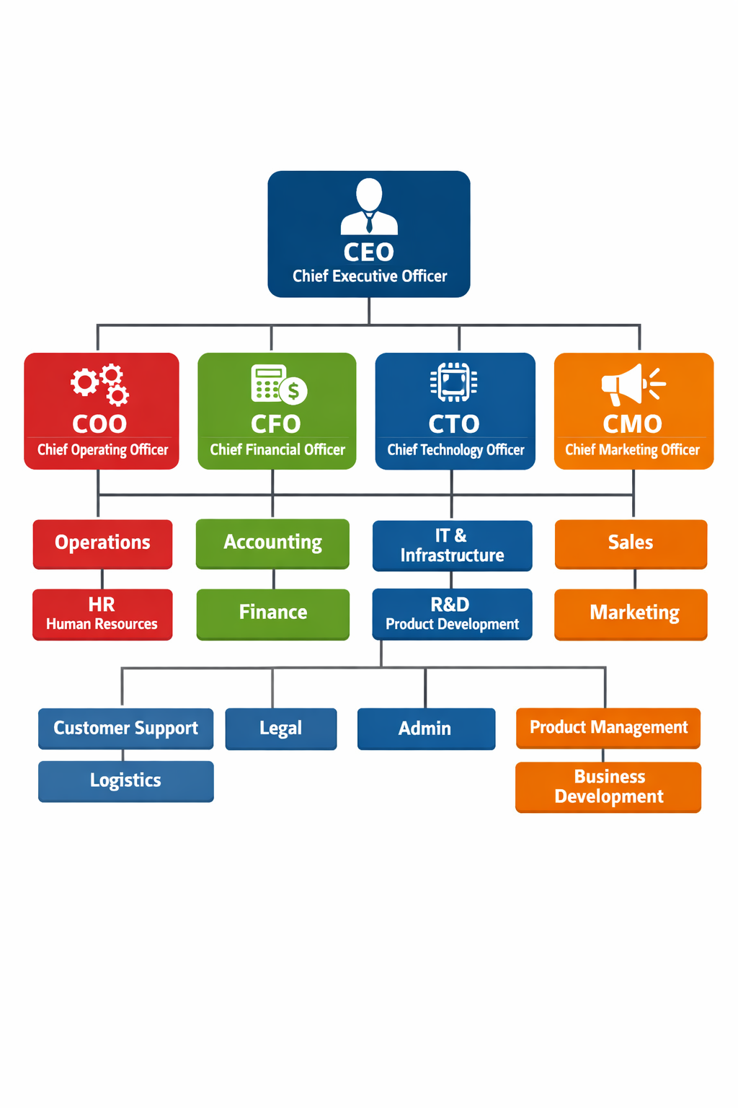
Succession Planning for Shareholder Groups
Effective succession planning requires commitment from senior management, clear job descriptions, and a transparent process to ensure the right skills are in place for future leadership transitions within the group.

Slide 6
Preparing for Sale
Organize Financial Statements
Grow Market Share
Control Costs
Prepare Documentation
Focus on expanding your market share to enhance your business's appeal. Increased visibility and customer loyalty can significantly boost potential valuations when selling your business.
Implement cost-control strategies to improve profit margins. By managing expenses effectively, you can present a healthier financial picture, making your business more attractive to potential buyers.
Ensure your financial statements are accurate and up-to-date. Clear and organized records provide potential buyers with confidence, demonstrating your business's financial health and operational effectiveness.
Gather essential documentation, including management processes and contracts. This comprehensive preparation helps facilitate a smoother sale process, making it easier for buyers to evaluate and understand your business.

Slide 7

Deal Structure and Seller Risk
Understanding the structural risks in a sale is crucial. Buyers might negotiate terms that rely on future performance, potentially leaving sellers vulnerable if new owners do not succeed. Brokers can mitigate these risks.

Slide 8


ESOP: Employee Ownership Insights

Slide 9
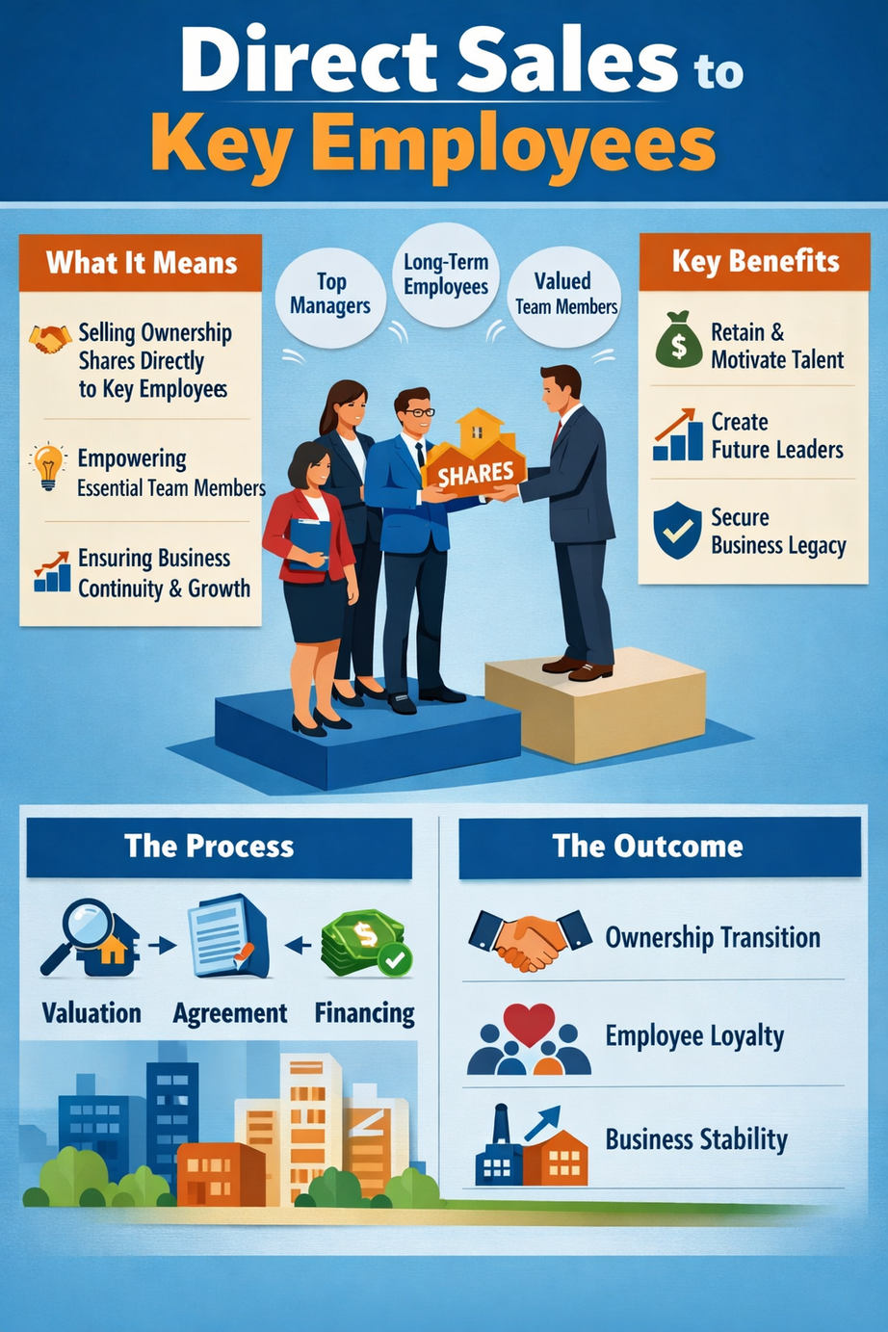
Direct Sale to Key Employees
A direct sale to key employees simplifies ownership transfer with a predetermined price. The valuation includes factors like assets and goodwill, ensuring both parties understand the business's worth before finalizing the deal.

Slide 10

Understanding Venture Failure and Bankruptcy
Many startups face failure, leading to bankruptcy as a protective measure against creditors. Entrepreneurs often delay action, making timely communication with employees crucial during these challenging times.

Slide 11
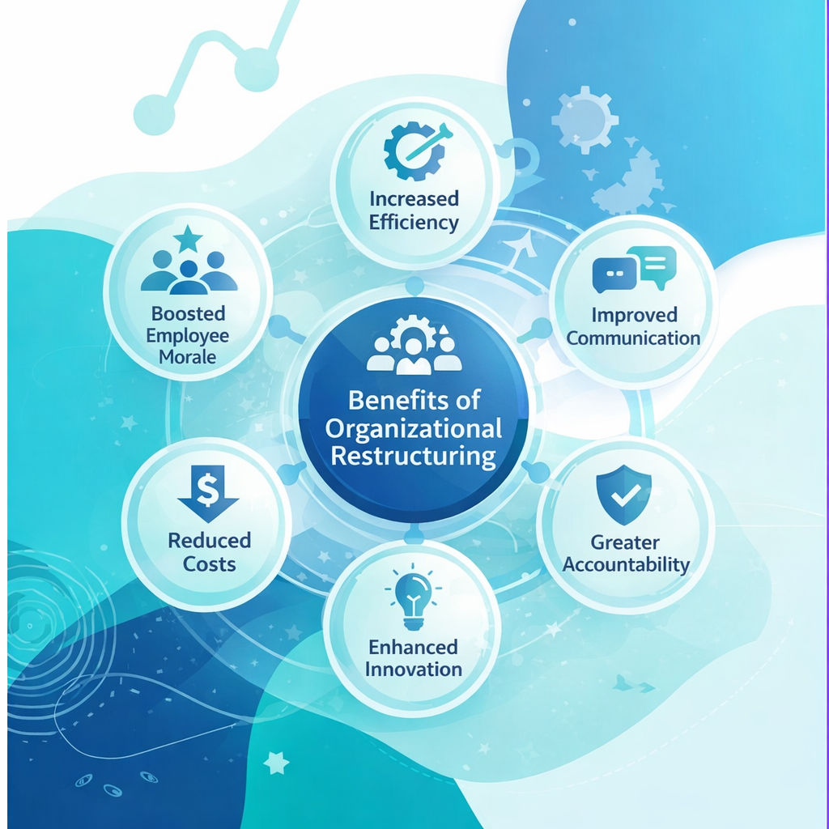
Understanding Chapter 11 Benefits
Chapter 11 provides a vital chance to address financial issues. Early filing allows businesses to restructure effectively and negotiate with creditors, increasing the likelihood of a successful turnaround while maintaining operations.

Slide 12


Chapter 7 vs. Chapter 13 Overview

Slide 13
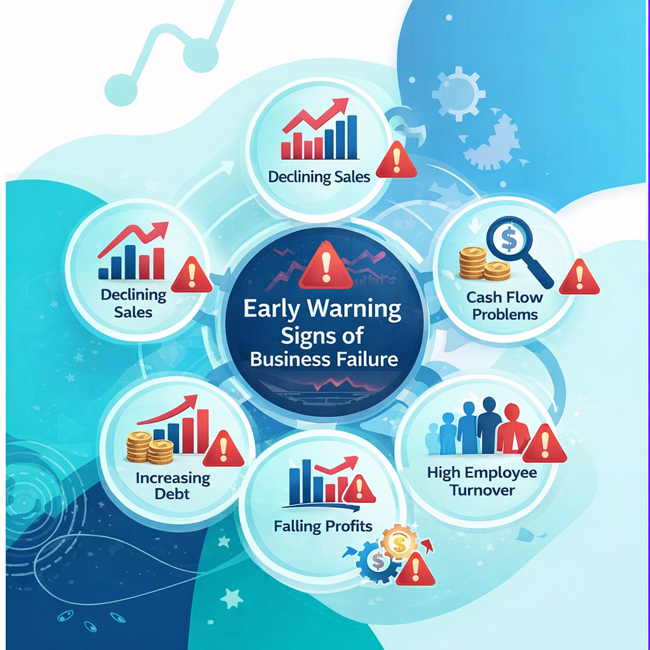
Early Warning Signs of Failure
Recognizing interconnected stress points early is crucial. Poor financial management, deep discounts, and unaddressed customer complaints can spiral into significant challenges, leading to potential business failure if not acted upon swiftly.

Slide 14

Managing Cash Flow & Market Changes
Effective cash flow management is crucial for adapting to fluctuating market conditions. Accurate projections enable businesses to anticipate challenges and seize opportunities, ensuring long-term sustainability and growth.

