Slide 1


MGMT 420
The Financial Plan
Chapter 10

Slide 2
The Financial Plan Overview
Timing
Timing ensures funds are available when needed.
Flow of Funds
Effective management of cash flow supports operations.
Liquidity Management
Maintaining liquidity helps meet financial obligations.

Slide 3





Budgeting and Forecasting Essentials
Short-Term Expenses
Long-Term Investments
Monthly operating costs include rent and ingredients.
Capital budgeting involves purchasing essential equipment.
Sales Forecasting
Financial Planning
Anticipating demand through market analysis is crucial.
Accurate budgeting guides strategic business decisions.

Slide 4

Cost
ANALYSIS
01
Leasing
Leasing a machine allows for lower initial costs, preserving capital for other operational expenses and offering flexibility.
02
Buying
Purchasing equipment provides full ownership benefits, potential tax deductions, and long-term savings but requires higher upfront investment.

Slide 5
Sales Seasonality
Spring Peak
Summer Surge
Autumn Decline
The landscaping service experiences its highest demand in spring as new projects begin.
In summer, service requests continue to increase, driving revenue and customer engagement.
With the arrival of autumn, demand drops significantly, preparing for winter's slowdown.

Slide 6



Understanding Pro Forma Financial Statements
Income Statement
Cash Flow
Balance Sheet
Understanding cash flow's distinction from profit is vital.
Snapshot of assets, liabilities, and equity at year-end.
Monthly projections of revenue and expenses are crucial.

Slide 7

Pro Forma
Financial Projections
3 Year Projections
Projected 10% annual growth driven by market expansion and brand strategy.
$250,000 → $275,000 → $302,500
Key Growth Drivers:
Customer Base Expansion: Launch of a loyalty rewards program and increased online visibility through social media marketing.
Product Line Diversification: Adding new seasonal collections and locally sourced artisan products.
Omnichannel Strategy: Combining in-store and e-commerce sales to capture a wider audience.
Brand Recognition: Leveraging influencer partnerships and community events to drive awareness and repeat business.
Operational Efficiency: Improved inventory management and vendor relationships reduce costs, boosting net margins.

Slide 8
Pro Forma
Final Projections
Thread & Thistle Clothing Boutique
This section outlines pro forma financial projections for the startup boutique, assuming an initial launch with $250,000 in first-year sales and a 10% annual growth rate.

Slide 9
Pro Forma
Financial Projections
Thread & Thistle Clothing Boutique
Proforma Financial Statement illustrate the anticipated financial outcomes under baseline assumptions for sales growth, cost structure, and profitability — serving as a foundation for investor discussions and internal planning.

Slide 10
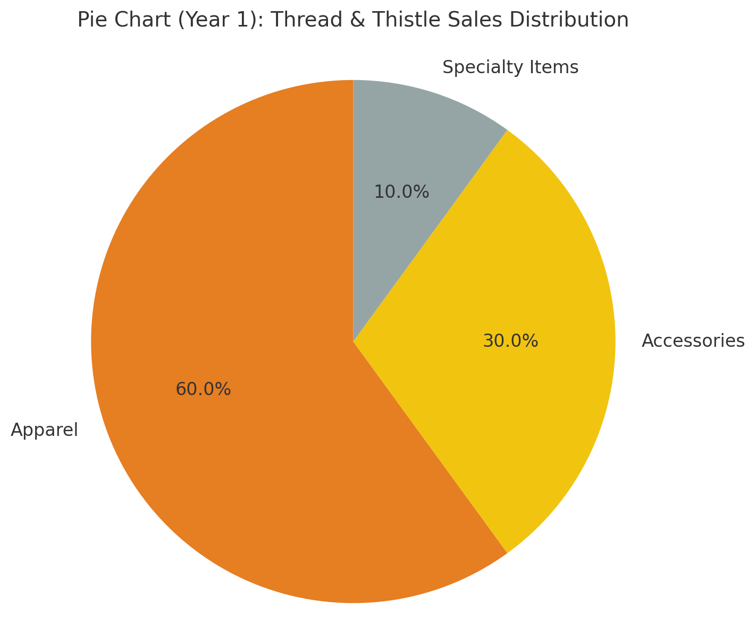
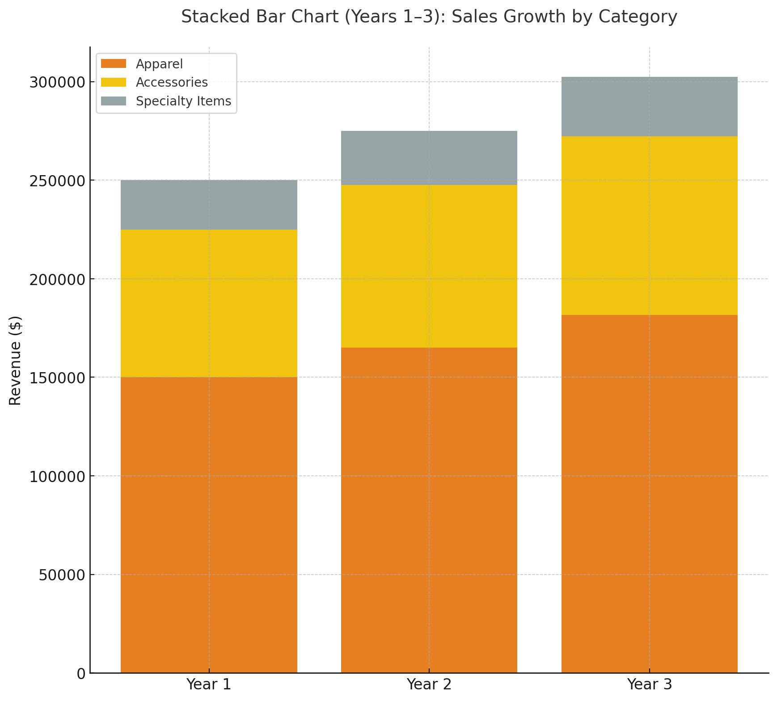
Pro Forma Revenue Forecast
Projected Sales by Category (Base Case Scenario)
Revenue projections are based on a diversified product mix that balances apparel, accessories, and specialty items. This composition supports consistent sales growth and reduces reliance on a single category.
Year 1 Sales Mix
Apparel: $150,000 (60%)
Accessories: $75,000 (30%)
Specialty Items: $25,000 (10%)
Pro forma projections assume 10% annual growth per category.

Slide 11
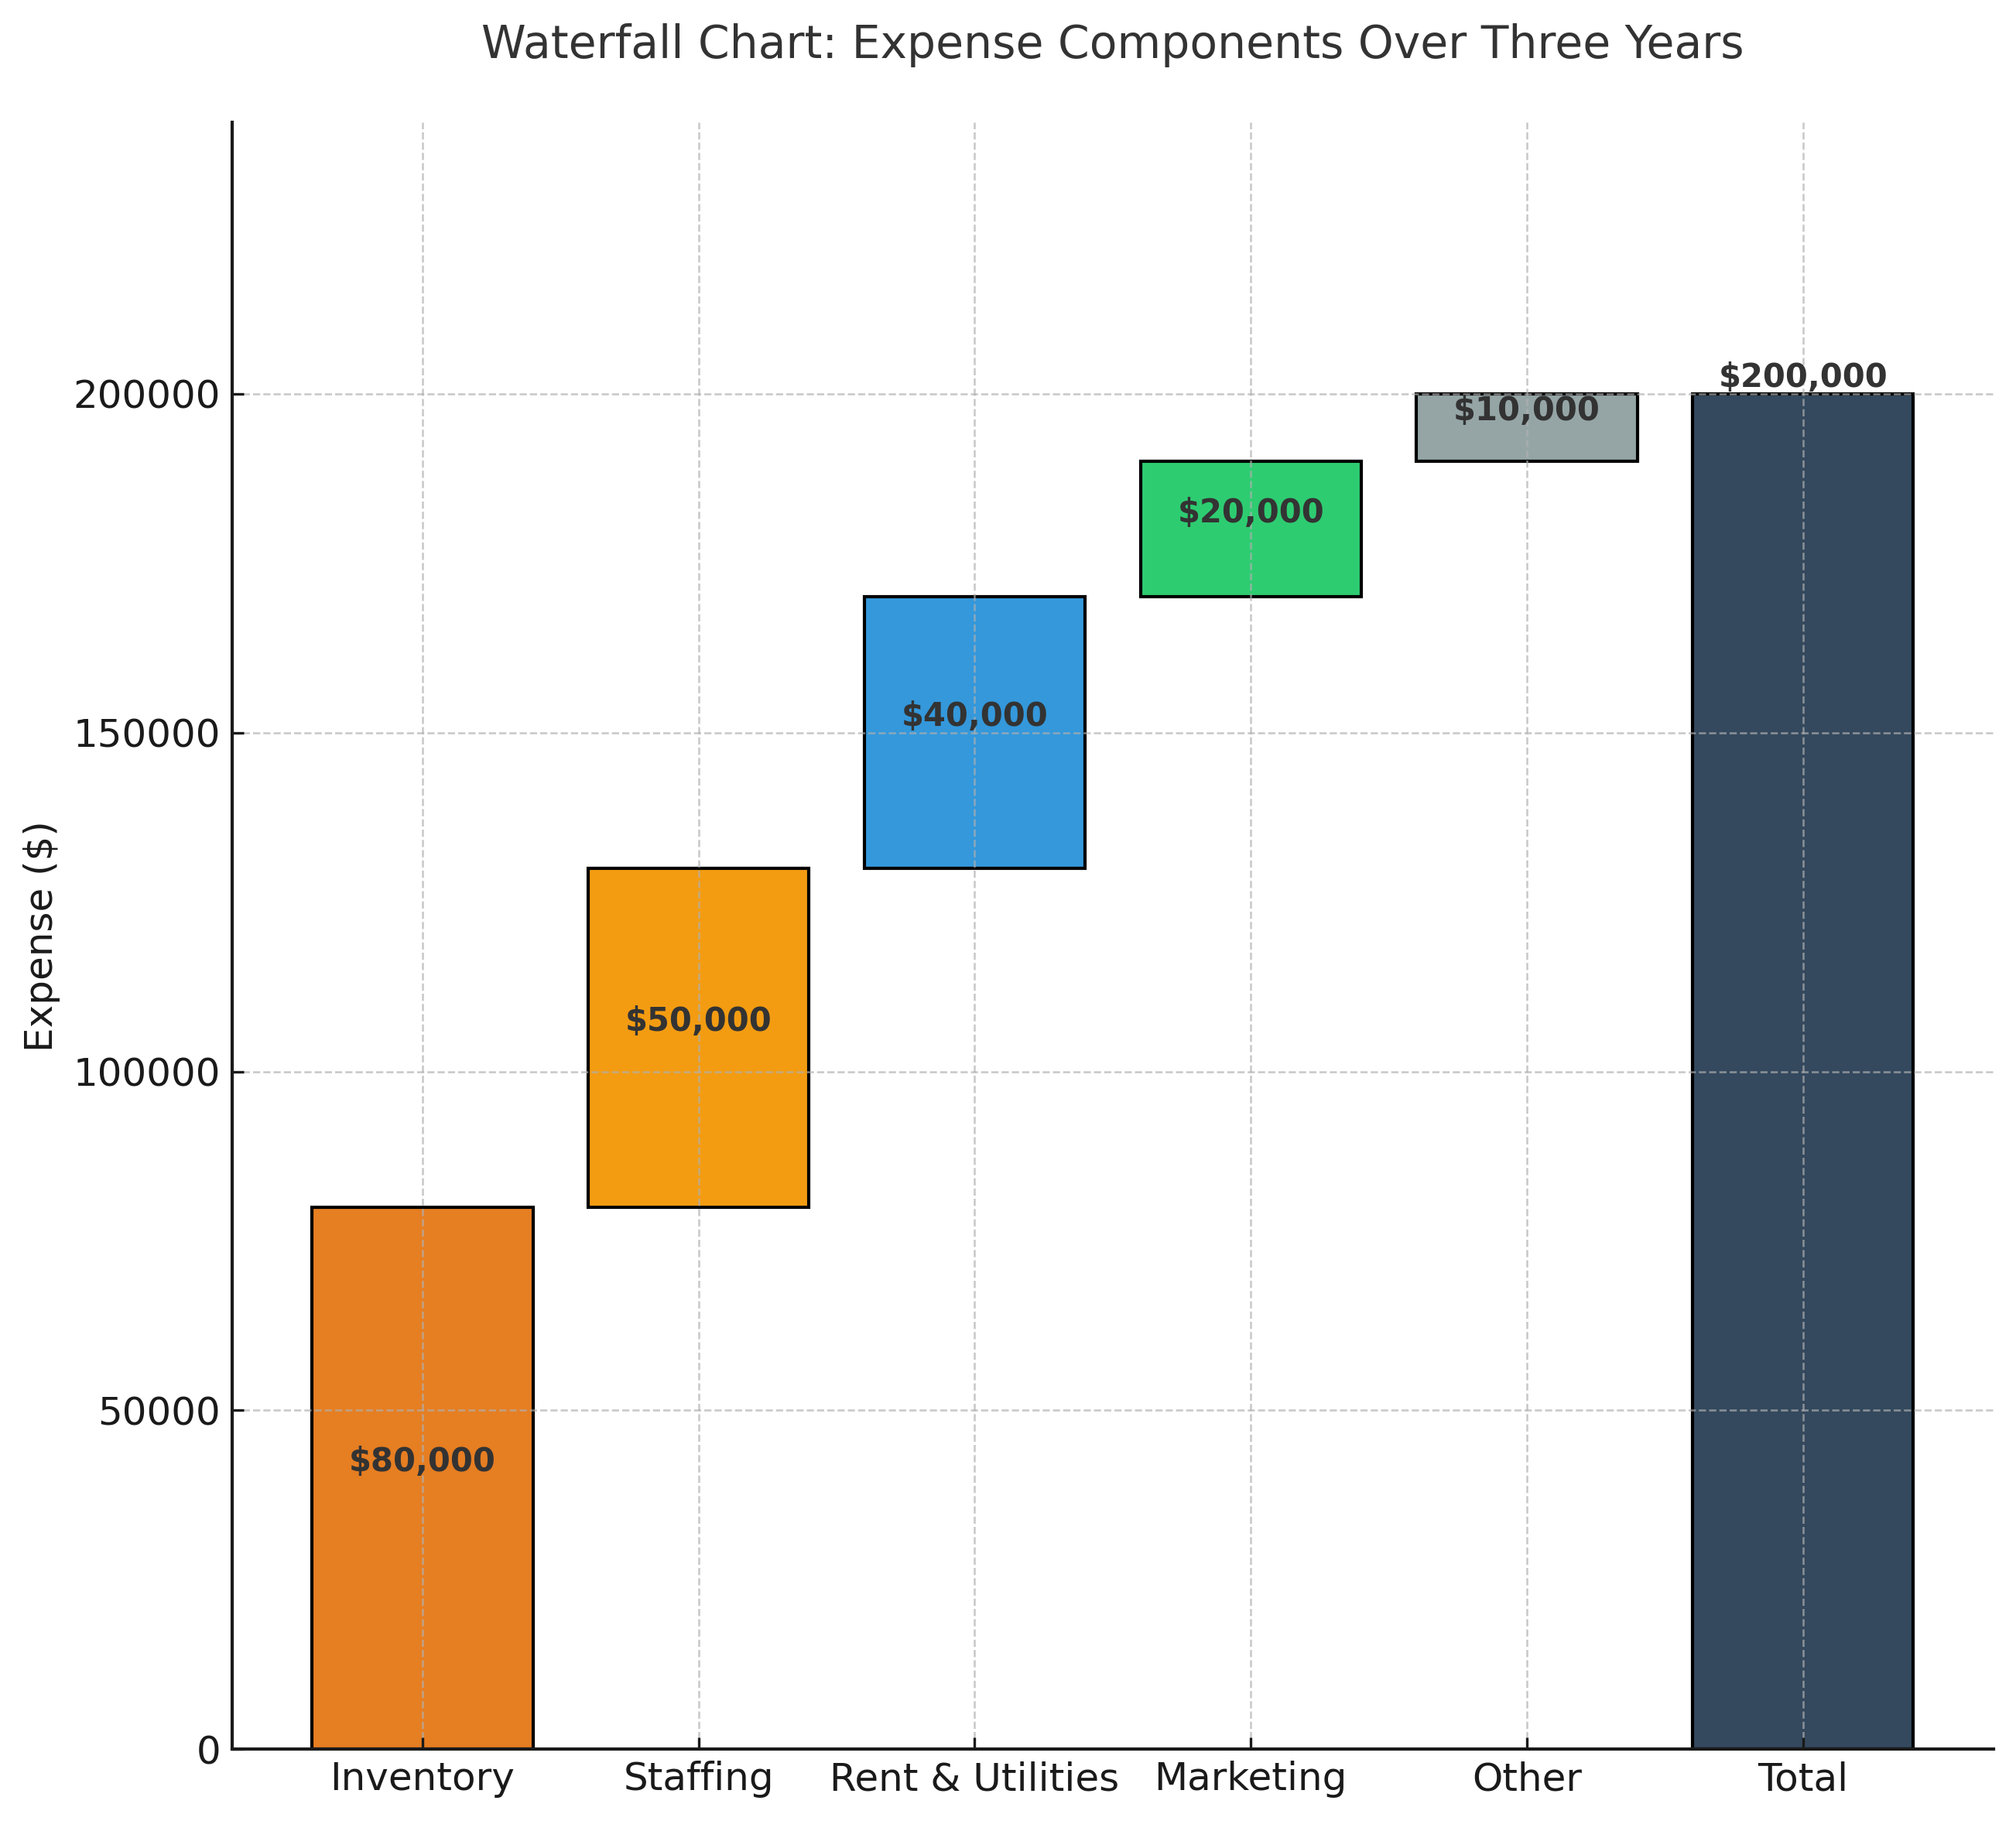
Pro Forma Expense Forecast
Projected Operating Expenses (Years 1–3)
Operating expenses are forecasted to grow more slowly than revenue as the startup scales. Initial costs include inventory procurement, rent, staffing, and marketing. By Year 3, economies of scale and improved vendor terms are expected to improve cost efficiency and overall margins.
Projected Expenses:
Inventory: 40%
Staffing: 25%
Rent & Utilities: 20%
Marketing: 10%
Other: 5%
Expense growth rate: ~7% annually vs. 10% revenue growth.

Slide 12
Pro Forma Income Statement
Projected Operating Expenses (Years 1–3)
The pro forma income statement anticipates strong early profitability as fixed costs stabilize and gross margins improve. These projections assume steady sales growth and consistent cost control.
Year | Projected Sales | Projected Expenses | Net Income | Net Margin
Year 1 | $250,000 | $210,000 | $40,000 | 16%
Year 2 | $275,000 | $230,000 | $45,000 | 17%
Year 3 | $302,500 | $244,500 | $58,000 | 19%

Slide 13

Startup Outlook & Financial Stability
Sustainability and Growth Path
The pro forma projections illustrate a financially sustainable startup model with positive cash flow by the end of Year 1 and increasing net margins through Year 3.
Continued focus on brand development, supply chain optimization, and digital marketing will strengthen long-term profitability and attract investor confidence.

Slide 14

Cash Flow
01
Direct
The direct method shows cash inflows and outflows, providing a clear view of actual cash transactions over time.
02
Indirect
The indirect method adjusts net income for non-cash transactions, helping to reconcile accounting profits with cash flow.

Slide 15

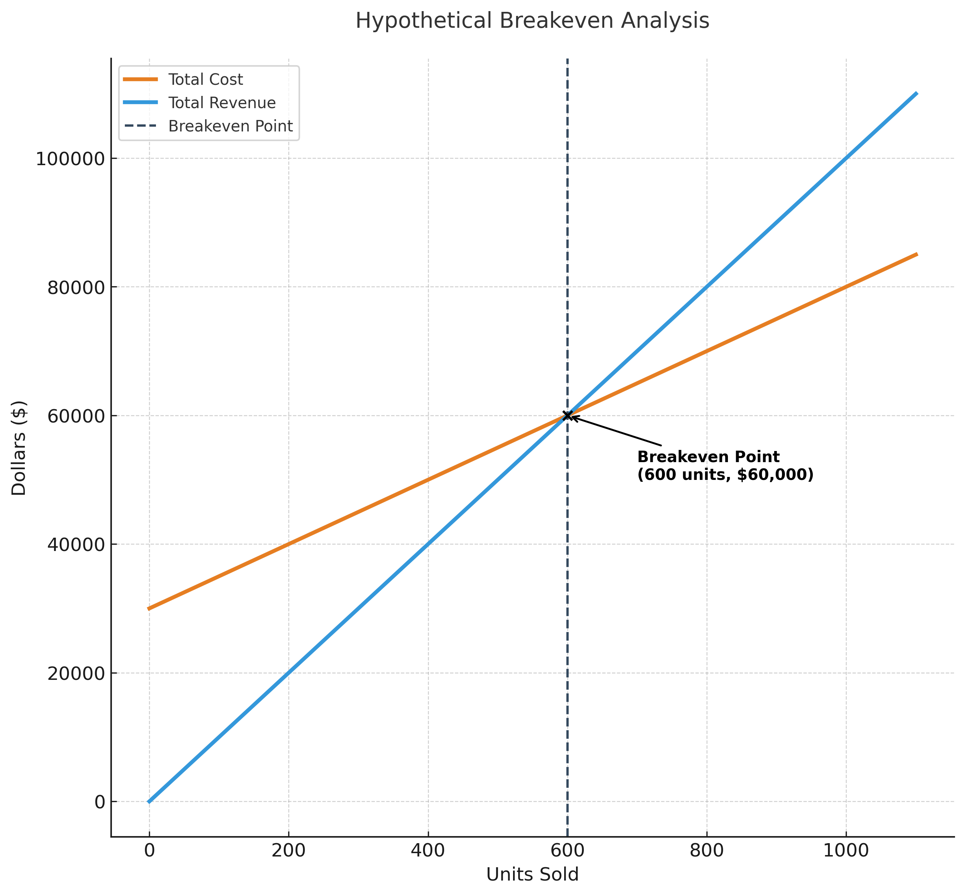
Break-Even Analysis and Cost Challenges
Units Needed
Cost Classification
Calculate total coffee cups needed to break even.
Understanding costs can be complicated but essential.

Slide 16

Sources and Applications
This section explains how businesses obtain and utilize key financial tools to support decision-making and performance analysis. It covers sources of financial information such as income statements, balance sheets, and cash flow reports—each providing insight into profitability, liquidity, and overall financial health. The application aspect focuses on how these tools are used to plan budgets, forecast growth, assess risk, and evaluate investments.

Slide 17



Essential Financial Software Tools for Businesses
Spreadsheets
Accounting Software
Software's Role
Essential for creating financial projections and models.
Improves accuracy and efficiency in financial planning.
Streamlines payroll, invoicing, and inventory management tasks.

Slide 18

Financial Software Tools
Utilizing software like spreadsheets and accounting tools enhances accuracy and efficiency, allowing businesses to model projections and test critical assumptions effectively.
Tool | Purpose | Example Applications
QuickBooks | Accounting & bookkeeping | Invoicing, payroll, expense tracking
Microsoft Excel / Google Sheets | Financial modeling | Budgets, cash flow projections, what-if analysis
SAP S/4HANA Finance | Enterprise resource planning (ERP) | Integrates financial reporting with operations
Oracle NetSuite | Cloud-based accounting | Consolidated financials, forecasting, automation
FreshBooks | Small-business finance | Billing, expense tracking, time tracking
Xero | Online accounting | Bank reconciliation, reporting, collaboration

